Slide 1
Midterm Review
CS436/536: Introduction to
Machine Learning
Zhaohan Xi
Binghamton University
^{zxi1@binghamton.edu}

Slide 2
Learning Problem Setup
UNKNOWN TARGET FUNCTION
$$f:𝒳→𝒴$$
Fixed, Unknown
(optimal credit approval function)
$$y_{n}=f(x_{n})$$
TRAINING EXAMPLES
$$\left(x_{1},y_{1}\right), \left(x_{2},y_{2}\right), …,(x_{N},y_{N})$$
Given Dataset
(historical records of credit customers)
LEARNING
ALGORITHM
$$𝒜$$
FINAL HYPOTHESIS
$$g≈f$$
(learned credit approval function)
HYPOTHESIS SET
$$ℋ$$
(set of candidate functions)

Slide 3
Learning
Start with a set of candidate hypotheses $ℋ$ which likely represent $f$
$ℋ=\{h_{1},h_{2},…\}$ The hypothesis set or model
Select a hypothesis $g$ from $ℋ$
Using a learning algorithm
Use $g$ for new customers
Hope that $g≈f$
$𝒳,𝒴$ and $𝒟$ are given by the learning problem
The target function $f$ is fixed but unknown
We choose $ℋ$ and the learning algorithm
A Decision Problem: What is the Criterion?
A Computational Problem

Slide 4
A Simple Learning Model
Input vector $x={\left[x_{1},x_{2},…,x_{d}\right]}^{T}$
Compute a “credit score” by giving
importance weights to the different inputs: $creditscore=\sum_{i=1}^{d}{w_{i}x_{i}}$
Decision rule:
If $creditscore>threshold$: Approve credit (good credit score)
If $creditscore<threshold$: Deny credit (poor credit score)
How to choose the importance weights $w_{i}$?
input $x_{i}$ is important in deciding credit approval $⇒$ large $w_{i}$
input $x_{i}$ has a beneficial effect to credit $⇒$ $w_{i}>0$ (weighs positively)
input $x_{i}$ has an adverse effect on credit $⇒$ $w_{i}<0$ (weighs negatively)

Slide 5
A Simple Learning Model
Decision rule:
If $creditscore>threshold$: Approve credit (good credit score) $⇒$ output +1
If $creditscore<threshold$: Deny credit (poor credit score) $⇒$ output -1
Can be written formally as:
$$h\left(x\right)=sign\left(\left(\sum_{i=1}^{d}{w_{i}x_{i}}\right) −threshold\right)$$
Simplifying a little…
$$h\left(x\right)=sign\left(\left(\sum_{i=1}^{d}{w_{i}x_{i}}\right)+w_{0}1\right)$$
$w_{0}$ is a “bias weight” which corresponds to the threshold: Approve if $\sum_{i=1}^{d}{w_{i}x_{i}}>w_{0}$

Slide 6
A Simple Learning Model
$$h\left(x\right)=sign\left(\left(\sum_{i=1}^{d}{w_{i}x_{i}}\right)+w_{0}1\right)$$
$$=sign\left(w_{0}1+w_{1}x_{1}+w_{2}x_{2}+…+w_{d}x_{d}\right)$$
$w=\left[\begin{aligned}w_{0} \\ w_{1} \\ w_{2} \\ … \\ w_{d}\end{aligned}\right]∈ℝ^{d+1}$ $x=\left[\begin{aligned}x_{0} \\ x_{1} \\ x_{2} \\ … \\ x_{d}\end{aligned}\right]∈{1×ℝ}^{d}$ (where $x_{0}=1$)
$$h\left(x\right)=sign\left(w^{T}x\right)$$

Slide 7
The Perceptron Hypothesis Set
We define a hypothesis set $ℋ$
$$ℋ=\{h\left(x\right)=sign(w^{T}x)\}$$
The perceptron or linear separator

Slide 8
Geometry of The Perceptron in $ℝ^{2}$
Income
A line separates +1 from -1
Age

Slide 9
Geometry of The Perceptron in $ℝ^{2}$
Income
Income
Age
Age
Which one to pick?

Slide 10
Select a Hypothesis Using Data
Our data suggests we pick this
X
O
X
O
X
X
X
O
O
Income
O
Income
O
O
O
X
X
X
O
X
O
Age
Age
misclassified data
perfectly classified

Slide 11

How to Learn a Final Hypothesis $g$ from $ℋ$?
Want: Select $g$ from $ℋ$ so that $g≈f$
Certainly want $g≈f$ on the dataset $𝒟$, i.e.,
$g\left(x_{n}\right)=y_{n}$ for each $\left(x_{n},y_{n}\right)$ in $𝒟$
But $ℋ$ is uncountably infinite
How to find $g$ in the infinite hypothesis set $ℋ$?
Start with some weights and improve it iteratively
(Coming Soon: The Perceptron Learning Algorithm)
X
O
X
X
O
Income
O
O
X
X
O
Age

Slide 12
How Does the Bin Model Relate to Learning?
Unknown target function $f$
A known fixed hypothesis $h$
Income
Income
Age
Age

Slide 13
How Does the Bin Model Relate to Learning?
$$𝒳$$
$μ$: the red area
Correctly classified, good events
Income
Misclassified, bad events
Age

Slide 14
The Error Function
$$𝒳$$
Green: $h\left(x\right)=f(x)$
Red: $h\left(x\right)≠f(x)$
$$E_{out}\left(h\right)=ℙ_{x}[h\left(x\right)≠f(x)]$$
(size of red region)
But this is UNKNOWN
Income
Age
Age

Slide 15
The Error Function
Green: $h\left(x\right)=f(x)$
Red: $h\left(x\right)≠f(x)$
$E_{in}\left(h\right)=$ fraction of sampled data points in red region
i.e. misclassified data points
$$E_{in}\left(h\right)=\frac{1}{N}\sum_{n=1}^{N}{⟦h\left(x_{n}\right)≠f(x_{n})⟧}$$
We know this
$$𝒳$$
X
O
X
O
Income
O
O
X
X
O
Age

Slide 16
Learning Problem Setup with Probability
UNKNOWN TARGET FUNCTION
$$f:𝒳→𝒴$$
UNKNOWN INPUT DISTRIBUTION
$$P(x)$$
$$y_{n}=f(x_{n})$$
TRAINING EXAMPLES
$$\left(x_{1},y_{1}\right), \left(x_{2},y_{2}\right), …,(x_{N},y_{N})$$
$$x_{1},x_{2},…,x_{N}$$
$$g\left(x\right)≈f(x)$$
LEARNING
ALGORITHM
$$𝒜$$
FINAL HYPOTHESIS
$$g$$
HYPOTHESIS SET
$$ℋ$$

Slide 17
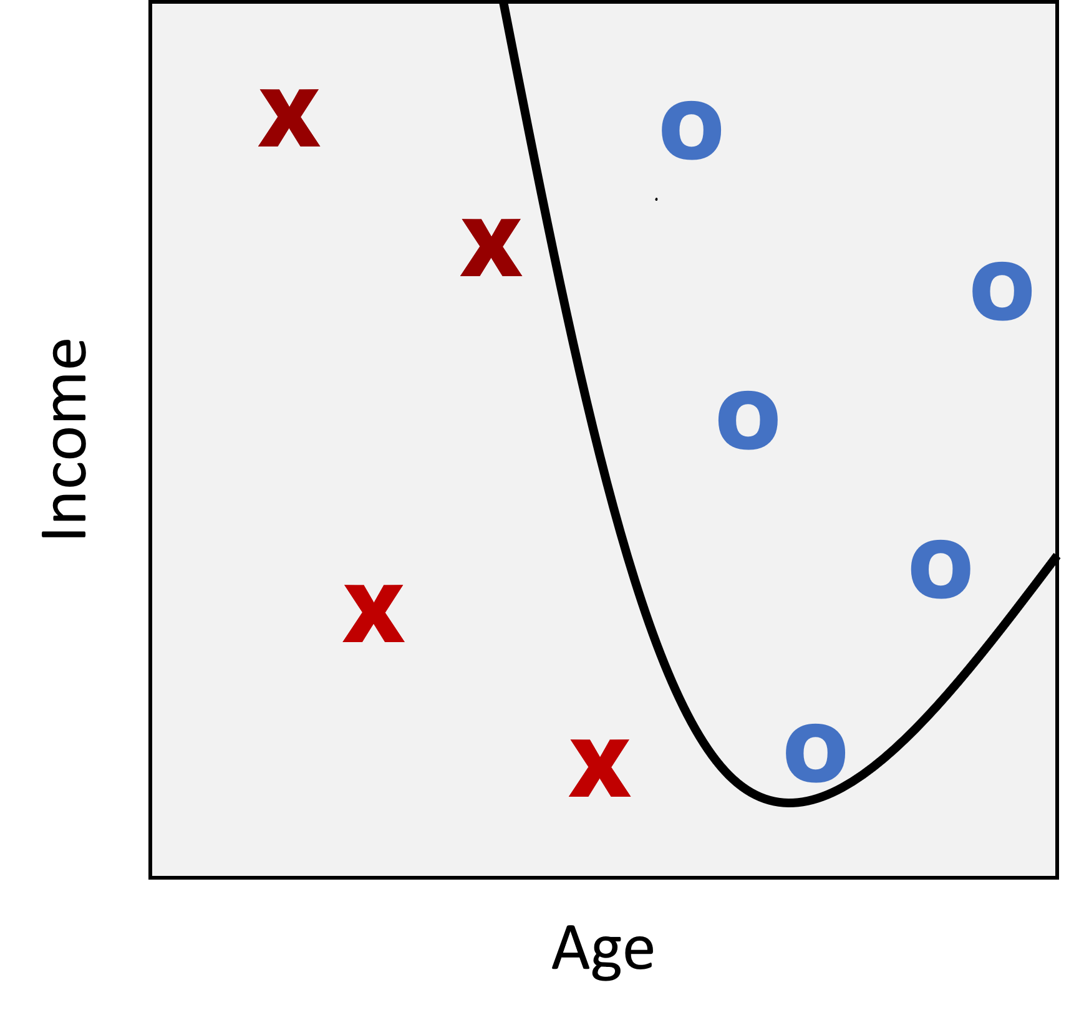
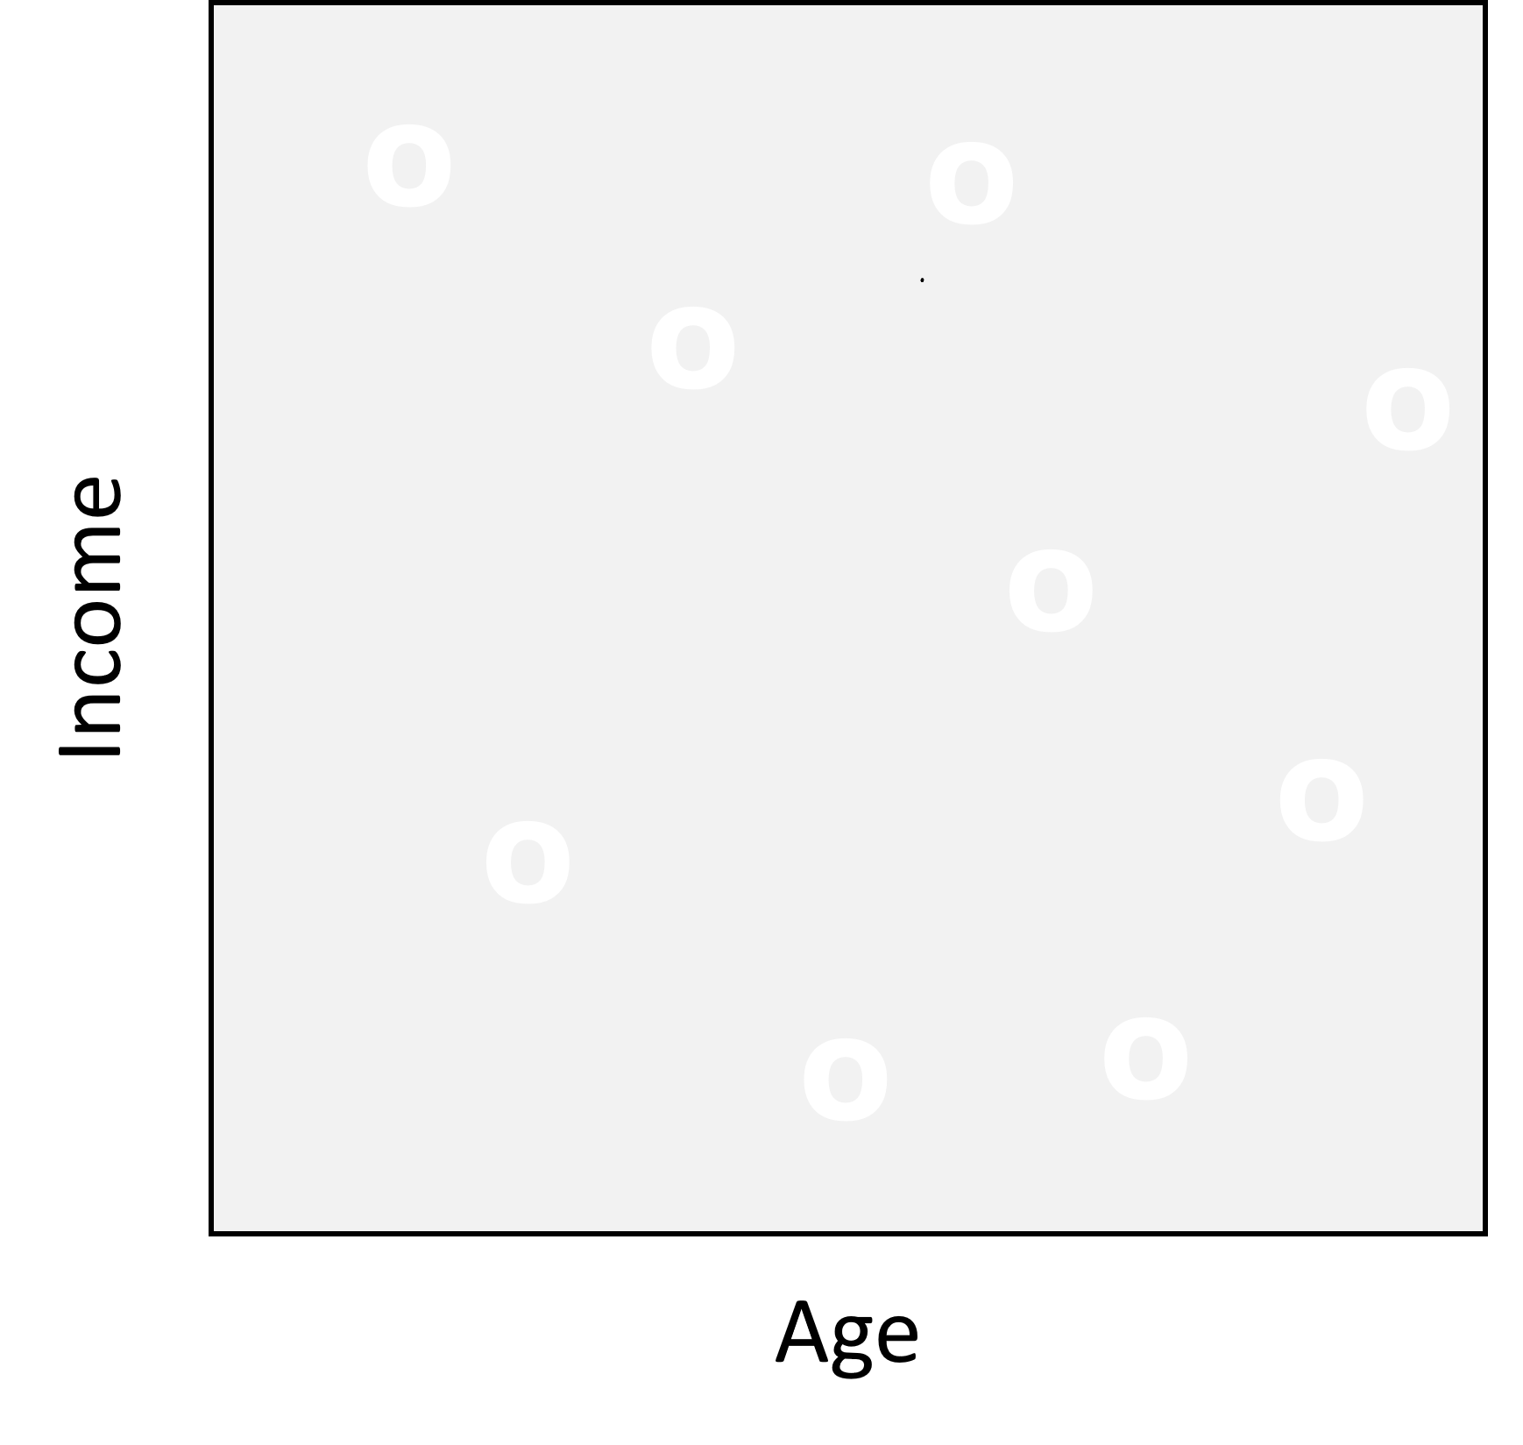
$$h_{1}$$
$$h_{2}$$
$$h_{3}$$
$$h_{M}$$
$$⋯$$
$$𝒟$$
$$⋯$$
$$E_{in}(h_{1})=3/9$$
$$E_{in}(h_{2})=0$$
$$E_{in}(h_{3})=4/9$$
$$E_{in}(h_{M})=4/9$$

Slide 18
Achieving Learning: $E_{out}≈0$
2 Conditions:
(1) $E_{in}(g)≈E_{out}(g)$ $⇒$ $E_{out}(g)≈0$
(2) $E_{in}(g)≈0$
How to ensure that (1) is satisfied? We cannot compute $E_{out}(g)$
Must be ensured theoretically (e.g. using Hoeffding’s inequality)
How to ensure (2) is satisfied? Use a good learning algorithm (e.g. PLA)

Slide 19
Feasibility of Learning (with Finite Models)
No Free Lunch: Cannot learn $f$ exactly from $𝒟$ over all $𝒳$
But, Can learn $f$ with high probability due to Hoeffding, if:
- $𝒟$ and the test data point are drawn i.i.d. from $P(x)$
- $ℋ$ is fixed and $g$ is selected from $ℋ$
To achieve learning: i.e. select $g$ from $ℋ$ so that $E_{out}\left(g\right)≈0$, we must ensure:
(Step 1) $E_{out}\left(g\right)≈E_{in}\left(g\right)$ -- Ensure $\left|ℋ\right|$ is small
Theorem. With probability at least $1−δ$, $E_{out}\left(g\right)≤E_{in}\left(g\right)+\sqrt{\frac{1}{2N}\log{\frac{2|𝓗|}{δ}}}$
(Step 2) $E_{in}\left(g\right)≈0$ -- Learning algorithm $𝒜$

Slide 20
The complexity of $f$
More complex target functions are harder to learn
Simple $f$ $⇒$ can use small $ℋ$ to get $E_{in}(g)≈0$ using smaller $N$
Complex $f$ $⇒$ need large $ℋ$ to get $E_{in}(g)≈0$ and need larger $N$

Slide 21
Learning Problem with Error Measure, Noisy Target
UNKNOWN TARGET DISTRIBUTION
$$P(y|x)$$
UNKNOWN INPUT DISTRIBUTION
$$P(x)$$
$$y_{n}\sim P(y|x)$$
TRAINING EXAMPLES
$$\left(x_{1},y_{1}\right), \left(x_{2},y_{2}\right), …,(x_{N},y_{N})$$
$$x_{1},x_{2},…,x_{N}$$
ERROR
MEASURE
$$g\left(x\right)≈f(x)$$
LEARNING
ALGORITHM
$$𝒜$$
FINAL HYPOTHESIS
$$g$$
HYPOTHESIS SET
$$ℋ$$

Slide 22
Linear Models for Three Learning Problems
Approve
or Deny
Classification
$$y∈\{−1,+1\}$$
Credit
Analysis
Amount
of Credit
Regression
$$y∈ℝ$$
Probability
of Default
Logistic Regression
$y∈$[0,1]
Fundamental: Building block for more complex models
First model to try!

Slide 23
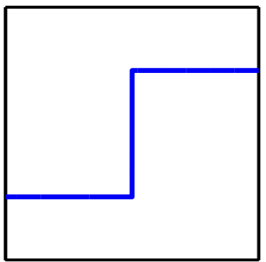

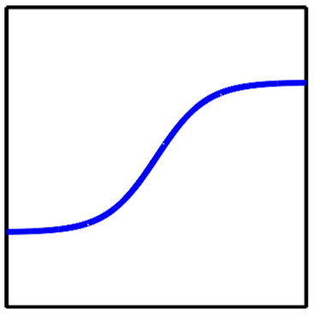
Linear Models: The Linear Signal
$$sign(w^{T}x)$$
$$\{−1,+1\}$$
Classification
$$w^{T}x$$
$$w^{T}x$$
$$ℝ$$
Regression
$$θ(w^{T}x)$$
$$[0,1]$$
Logistic Regression

Slide 24
Linear Model for Classification
$$ℋ=\left\{h:h\left(x\right)=sign\left(w^{T}x\right)\right\}$$
Classification error on point $x$: $e\left(h\left(x\right),f\left(x\right)\right)=⟦h\left(x\right)≠f(x)⟧$
Overall error is average value of point-wise error
$$E_{in}\left(h\right)=\frac{1}{N}\sum_{n=1}^{N}{e(h\left(x_{n}\right),f(x_{n}))}$$
$$E_{out}\left(h\right)=𝔼_{x}[e(h\left(x\right),f(x))]$$
Ultimate Goal: Minimize $E_{out}(h)$
Typical Learning Algorithm Goal: Minimize $E_{in}(h)$

Slide 25
How to Learn a Final Hypothesis $g$ from $ℋ$?
Want: Select $g$ from $ℋ$ so that $g≈f$
Certainly want $g≈f$ on the dataset $𝒟$, i.e.,
$g\left(x_{n}\right)=y_{n}$ for each $\left(x_{n},y_{n}\right)$ in $𝒟$
But $ℋ$ is uncountably infinite (more on this later)
How to find $g$ in the infinite hypothesis set $ℋ$?
Start with some weights and improve it iteratively
X
O
X
X
O
Income
O
O
X
X
O
Age

Slide 26
The Perceptron Learning Algorithm (PLA)
A simple iterative algorithm
$w\left(0\right)=0$
for iteration $t=1, 2, 3, …$ do
the weight vector is $w(t)$
from $\left(x_{1},y_{1}\right)$, $\left(x_{2},y_{2}\right)$, $…$,$\left(x_{N},y_{N}\right)$ pick any misclassified example
let $(x_{∗},y_{∗})$ be the misclassified example
$sign\left(w\left(t\right) ⋅x_{∗}\right)≠y_{∗}$
update the weights
$w\left(t+1\right)=w\left(t\right)+y_{∗}x_{∗}$
$t←t+1$
Start at some weights
Observe a misclassification
The update rule: Correct a misclassification
“incremental learning” one example at a time

Slide 27
The Perceptron Update Rule
$w\left(t+1\right)=w\left(t\right)+y_{∗}x_{∗}$
Mistake when $y_{∗}=+1$: Increase the score of $x_{∗}$
$w^{T}\left(t+1\right)x_{∗}$ = $\left(w^{T}(t)+x_{∗}^{T}\right)x_{∗}=w^{T}\left(t\right)x_{∗}+x_{∗}^{T}x_{∗}$
$>w^{T}\left(t\right)x_{∗}$
Mistake when $y_{∗}=−1$: Decrease the score of $x_{∗}$
$w^{T}\left(t+1\right)x_{∗}$ = $\left(w^{T}\left(t\right)−x_{∗}^{T}\right)x_{∗}=w^{T}\left(t\right)x_{∗}−x_{∗}^{T}x_{∗}$
$<w^{T}\left(t\right)x_{∗}$

Slide 28
The Perceptron Update Rule
$$y_{∗}=+1$$
and $w^{T}\left(t\right)x_{∗}<0$
obtuse angle
$$x_{2}$$
$$x_{2}$$
$$w(t)$$
acute angle
$$w(t+1)$$
$$w(t+1)$$
$$x_{1}$$
$$x_{1}$$
$$x_{∗}$$
$$x_{∗}$$

Slide 29
The Perceptron Update Rule
$$y_{∗}=−1$$
and
$$w^{T}\left(t\right)x_{∗}>0$$
$$x_{2}$$
$$x_{2}$$
$$w(t+1)$$
$$w(t+1)$$
$$w(t)$$
$$x_{1}$$
$$x_{∗}$$
$$x_{∗}$$

Slide 30
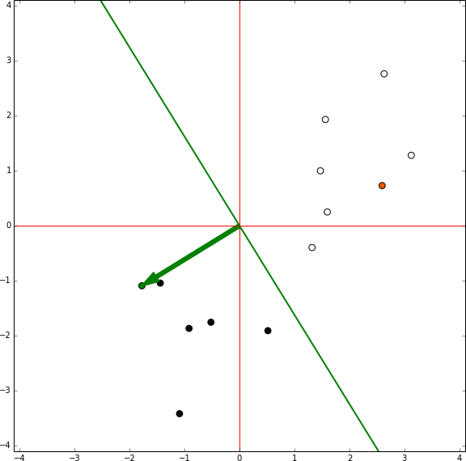
Does PLA Work?
Theorem: If the data can be fit by a linear separator,
then after some finite number of steps, PLA will find one

Slide 31
Pocket Algorithm (for Linear Classification)
The Pocket Algorithm:
Run the Perceptron Learning Algorithm $w\left(t+1\right)=w\left(t\right)+x_{∗}y_{∗}$
Here, $x_{∗}$ is any data point misclassified due to $w\left(t\right)$
In each round, record $E_{in}$ (and $w$) if it is the best $E_{in}$ observed so far
Other approaches:
Linear regression (coming soon)
Logistic regression (coming soon)
Linear Programming
$$\min_{w∈ℝ^{d+1}}{\frac{1}{N}\sum_{n=1}^{N}{1−y_{n}\left(w^{T}x_{n}\right)}}$$

Slide 32
Classifier Evaluation Metrics: Confusion Matrix
Confusion Matrix ($CM$):
In a confusion matrix with $m$ classes, $CM_{i,j}$ indicates # of tuples in class $i$ that were labeled by the classifier as class $j$
May have extra rows/columns to provide totals
Example of Confusion Matrix:
Actual class\Predicted class | C₁ | ¬ C₁
C₁ | True Positives (TP) | False Negatives (FN)
¬ C₁ | False Positives (FP) | True Negatives (TN)
Actual class\Predicted class | Bat first = yes | Bat first = no | Total
Bat first = yes | 6954 | 46 | 7000
Bat first = no | 412 | 2588 | 3000
Total | 7366 | 2634 | 10000

Slide 33
Classifier Evaluation Metrics: Accuracy, Error Rate, Sensitivity and Specificity
A\P | C | ¬C
C | TP | FN | P
¬C | FP | TN | N
 | P’ | N’ | All
Class imbalance problem
One class may be rare
E.g., fraud, or HIV-positive
Significant majority of the negative class and minority of the positive class
Handling the class imbalance problem
Sensitivity (recall): True positive recognition rate
Sensitivity = TP/P
Specificity: True negative recognition rate
Specificity = TN/N
Real-world truth
Predictions
Classifier accuracy, or recognition rate
Percentage of test set tuples that are correctly classified
Accuracy = (TP + TN)/All
Error rate: 1 – accuracy, or
Error rate = (FP + FN)/All

Slide 34
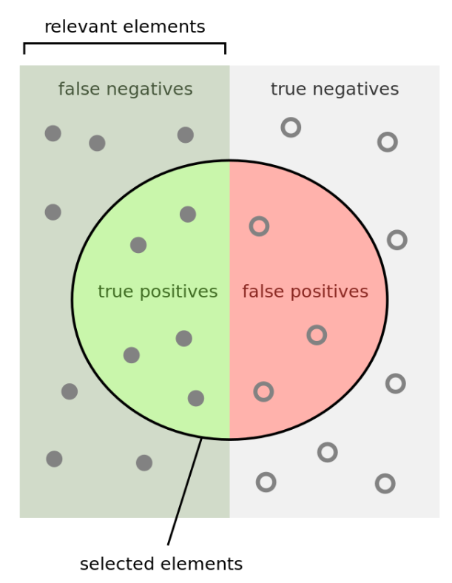
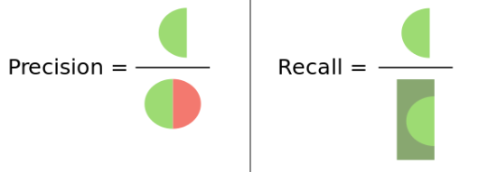
Classifier Evaluation Metrics: Precision and Recall, and F-measures
Precision (exactness): what % of tuples that the classifier labeled as positive are actually positive?
Recall (completeness): what % of positive tuples did the classifier label as positive?
Range: [0, 1]
A\P | C | ¬C
C | TP | FN | P
¬C | FP | TN | N
 | P’ | N’ | All
$$P=Precision=\frac{TP}{TP +FP}$$
$$R=Recall=\frac{TP}{TP +FN}$$
https://en.wikipedia.org/wiki/Precision_and_recall
Notes:
Left half: actual positives (P)
Right half: actual negatives (N)
Inside circle: predicted positive (P’)
Outside circle: predicted negative (N’)

Slide 35
Classifier Evaluation Metrics: Precision and Recall, and F-measures
The “inverse” relationship between precision & recall
We want one number to say if a classifier is good or not
F measure (or F-score): harmonic mean of precision and recall
In general, it is the weighted measure of precision & recall
F1-measure (balanced F-measure)
That is, when β = 1,
$$F_{β}=\frac{1}{α∙\frac{1}{P}+(1− α)∙\frac{1}{R}}=\frac{\left(β^{2}+1\right)P∗R}{β^{2}P+R}$$
Assigning β times as much weight to recall as to precision
$$F_{1}=\frac{2P∗R}{P+R}$$
Notes:
1/alpha - 1 = beta^2

Slide 36
Classifier Evaluation Metrics: Example
Use the same confusion matrix, calculate the measure just introduced
Sensitivity = TP/P = 90/300 = 30%
Specificity = TN/N = 9560/9700 = 98.56%
Accuracy = (TP + TN)/All = (90+9560)/10000 = 96.50%
Error rate = (FP + FN)/All = (140 + 210)/10000 = 3.50%
Precision = TP/(TP + FP) = 90/(90 + 140) = 90/230 = 39.13%
Recall = TP/ (TP + FN) = 90/(90 + 210) = 90/300 = 30.00%
F1 = 2 P × R /(P + R) = 2 × 39.13% × 30.00%/(39.13% + 30%) = 33.96%
Actual Class\Predicted class | cancer = yes | cancer = no | Total
cancer = yes | 90 | 210 | 300
cancer = no | 140 | 9560 | 9700
Total | 230 | 9770 | 10000
Notes:
Sensitivity = TP/P = 90/300 = 30%
Specificity = TN/N = 9560/9700 = 98.56%
Accuracy = (TP + TN)/All = (90+9560)/10000 = 96.50%
Error rate = (FP + FN)/All = (140 + 210)/10000 = 3.50%
Precision = TP/(TP + FP) = 90/(90 + 140) = 90/230 = 39.13%
Recall = TP/ (TP + FN) = 90/(90 + 210) = 90/300 = 30.00%
F1 = 2 P × R /(P + R) = 2 × 39.13% × 30.00%/(39.13% + 30%) = 33.96%

Slide 37
To Infinity …
How about infinite hypothesis set?
e.g. perceptron model

Slide 38
To Infinity …
Now on to Step 1: Ensure $E_{out}\left(g\right)≈E_{in}\left(g\right)$
But Hoeffding’s inequality only works for finite hypothesis set
Need to revisit model complexity

Slide 39
Thinking Aid: Dichotomies
Given a set of data point,
a dichotomy is any way to classify the data points into two classes
e.g. into two classes +1 and -1
$$x_{1}$$
How many possible dichotomies are there for this dataset?
8
$$x_{2}$$
$$x_{3}$$

Slide 40
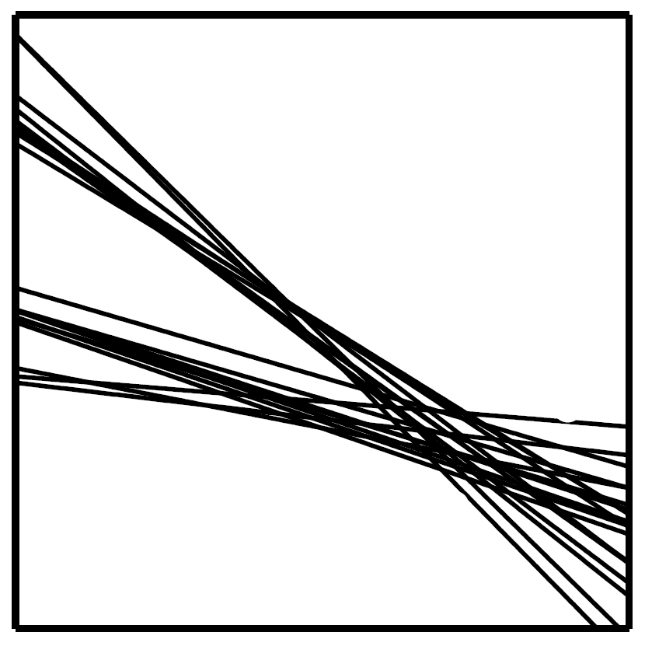
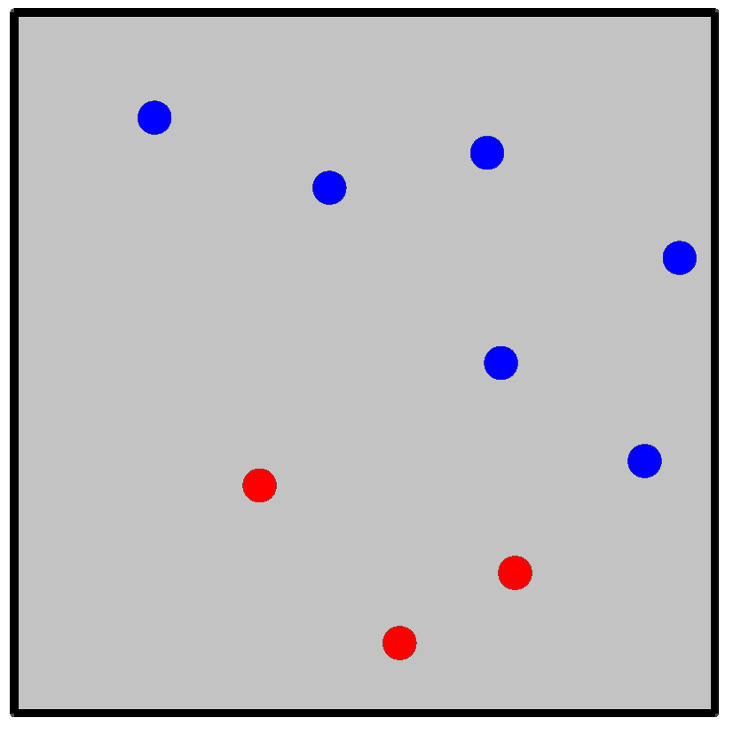
Data Reveals the True Diversity of $ℋ$
$$𝒟$$
$$ℋ$$
$ℋ$ through the eyes of $𝒟$
For $𝓓$, $𝓗$ is just one dichotomy

Slide 41
Effective Number of Hypotheses in $ℋ$
Effective size of $ℋ$:
Diversity of $ℋ$: number of dichotomies it can implement
Grows with $N$
growth function: how does the effective size of $ℋ$ grow with $N$?
$|ℋ|$ is the maximum possible diversity of $ℋ$
Bound the growth of the diversity of $ℋ$ as a function of $N$?

Slide 42
The Growth of the Effective Number of Hypotheses
 | $$x_{1}$$ | $$x_{2}$$ | $$x_{3}$$
$$h_{1}$$ | +1 | -1 | -1
$$h_{2}$$ | -1 | -1 | +1
$$h_{3}$$
$$h_{4}$$
$$h_{5}$$
$$h_{6}$$
$$…$$
$$x_{1}$$
$$x_{2}$$
$$x_{3}$$
8 dichotomies

Slide 43
The Growth Function $m_{ℋ}(N)$
Effective number of hypotheses in $ℋ$ through the eyes of $𝒟$
Definition: Let $x_{1},…,x_{N}∈𝒳$.
The dichotomies generated by $ℋ$ on these points are defined by
$$ℋ\left(x_{1},…,x_{N}\right)=\left\{ \left(h\left(x_{1}\right),…,h\left(x_{N}\right)\right) \right| h∈ℋ\}$$
Definition: The Growth Function $m_{ℋ}(N)$
The largest set of dichotomies induced by $ℋ$:
$$m_{ℋ}\left(N\right)=\max_{x_{1},…,x_{N}}{|ℋ(x_{1},…,x_{N})|}$$
$m_{ℋ}\left(N\right)≤2^{N}$
Worst-case

Slide 44
Example Growth Functions $m_{ℋ}(N)$
 | $$N$$
 | 1 | 2 | 3 | 4 | 5 | $$…$$
2D Perceptron | 2 | 4 | 8 | ? | $$…$$
 | +- -+ | ++ +- -+ -- | … | …
Ideally, want $m_{ℋ}(N)$ to grow slower than $2^{N}$
In general: A break point is any $k$ for which $m_{ℋ}\left(k\right)<2^{k}$

Slide 45
Example Growth Functions $m_{ℋ}(N)$
 | $$N$$
 | 1 | 2 | 3 | 4 | 5 | $$…$$
2D Perceptron | 2 | 4 | 8 | 14 | $$…$$
 | +- -+ | ++ +- -+ -- | … | …
Ideally, want $m_{ℋ}(N)$ to grow slower than $2^{N}$
In general: A break point is any $k$ for which $m_{ℋ}\left(k\right)<2^{k}$

Slide 46
Example Growth Functions $m_{ℋ}(N)$
 | $$N$$
 | 1 | 2 | 3 | 4 | 5 | $$…$$
2D Perceptron | 2 | 4 | 8 | 14 | $$…$$
Why Can't a 2D Perceptron Shatter $N>3$ Points?
A 2D perceptron is a linear classifier, meaning it can only separate points using a straight line.

Slide 47
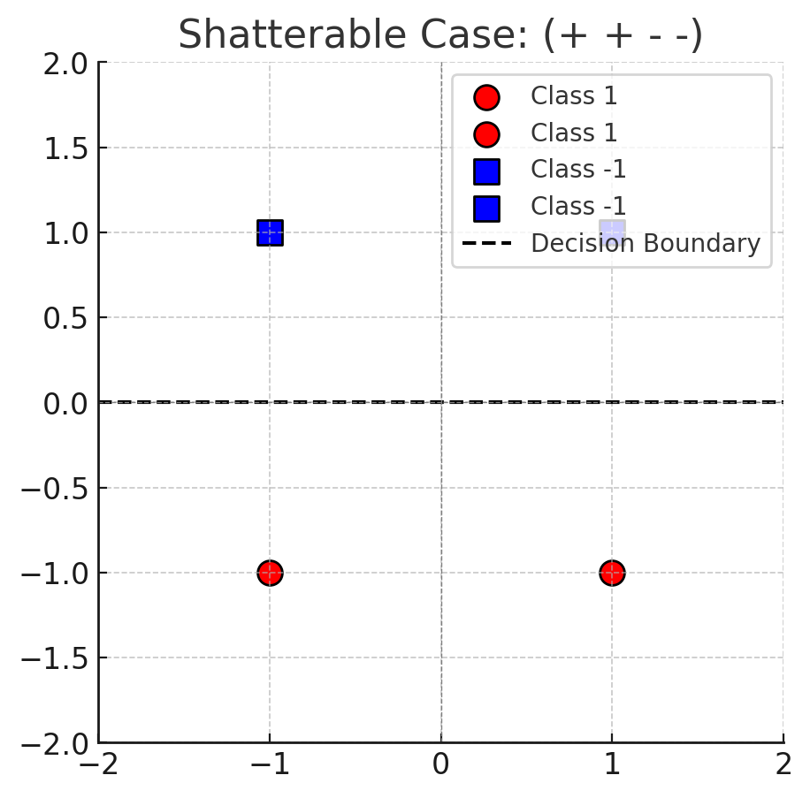
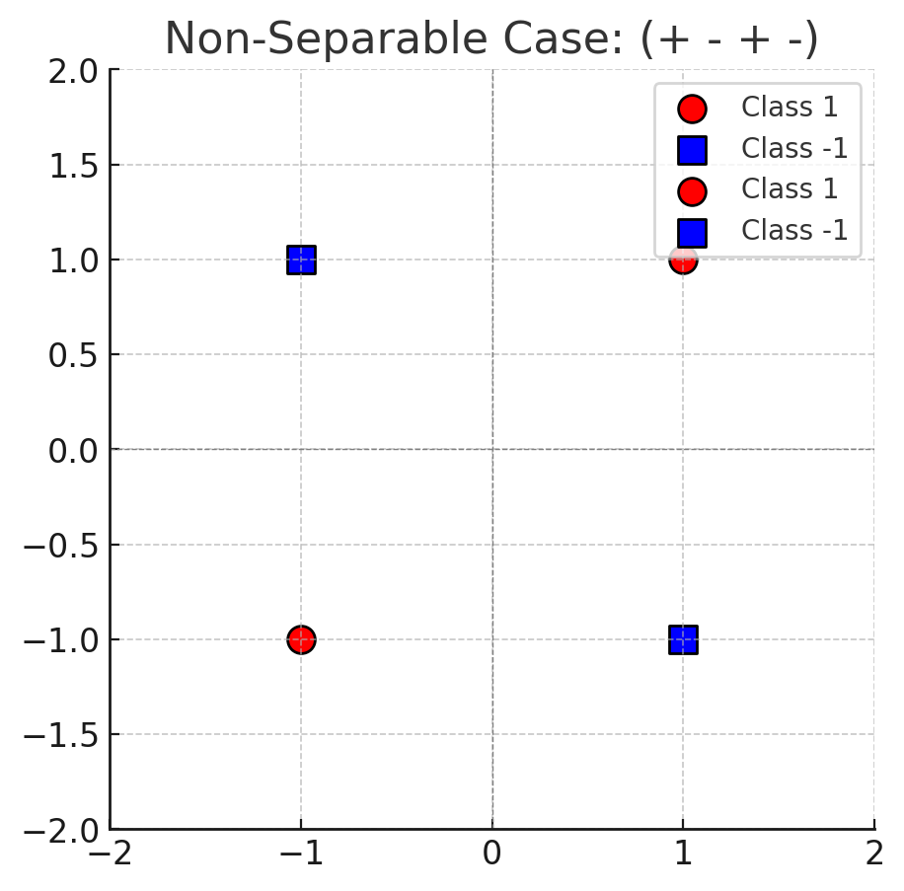

Slide 48
On break points
For a given hypothesis set $ℋ$,
To show that $k$ is a break point, we must prove that:
For all sets of $k$ points, the hypothesis class cannot shatter all $2^{k}$ possible labeling.
This means that there exists at least one labeling of $k$points that the hypothesis class cannot realize.

Slide 49
Example Growth Functions $m_{ℋ}(N)$
 | $$N$$
 | 1 | 2 | 3 | 4 | 5 | $$…$$
1D Positive Ray | 2 | 3 | 4 | 5 | $$…$$ | $$…$$
The 1D Positive Ray is a simple hypothesis class in one-dimensional space, where classification is determined based on a threshold. It is defined as:
$$h\left(x\right)= \left\{\begin{aligned}−1, x<threshold \\ +1, x≥threshold\end{aligned}\right.$$

Slide 50
Example Growth Functions $m_{ℋ}(N)$
 | $$N$$
 | 1 | 2 | 3 | 4 | 5 | $$…$$
1D Positive Ray | 2 | 3 | 4 | 5 | $$…$$ | $$…$$
N=1: (-) and (+)
N=2: (--), (-+) and (++)
N=3: (---), (--+), (-++), and (+++)
$m_{𝓗}\left(N\right)=N+1$

Slide 51
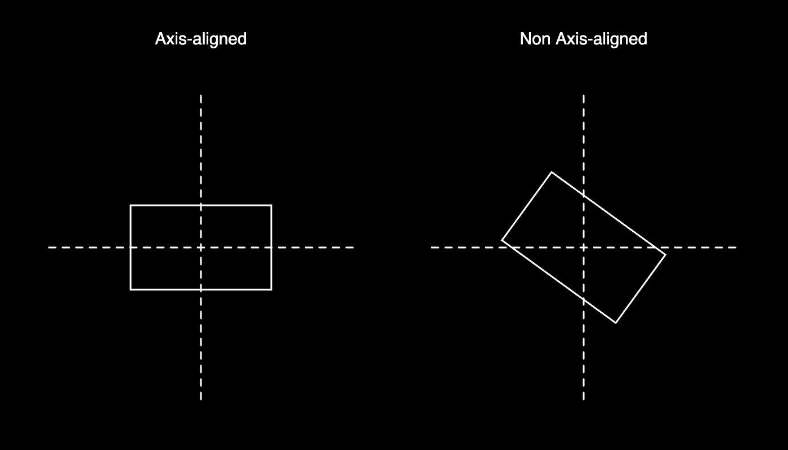
Example Growth Functions $m_{ℋ}(N)$
 | $$N$$
 | 1 | 2 | 3 | 4 | 5 | $$…$$
2D (Axis-Aligned) Positive Rectangle | 2 | 4 | 8 | 16 | $$<2^{5}$$ | $$…$$

Slide 52
Always Polynomial After Smallest Break Point
Theorem.
If $m_{ℋ}\left(k\right)<2^{k}$ for some value of $k$, then
$m_{ℋ}\left(N\right) ≤ \sum_{i=0}^{k−1}{\left({N \atop i}\right)}$, for all $N$
$= O(N^{k−1})$
Good news for $E_{out}\left(g\right)≤E_{in}\left(g\right)+O\left(\sqrt{\frac{1}{N}\log{\frac{m_{ℋ}(N)}{δ}}} \right)$
Polynomial!

Slide 53
Feasibility of Learning (Revisited)
To achieve learning:
i.e. select $g$ from $ℋ$ so that $E_{out}\left(g\right)≈0$,
we must ensure:
(Step 1) $E_{out}\left(g\right)≈E_{in}\left(g\right)$ [Generalization]
(Step 2) $E_{in}\left(g\right)≈0$ [Approximation]

Slide 54
The VC Dimension
Definition.
The Vapnik-Chervonenkis dimension of a hypothesis set $ℋ$,
denoted by $d_{VC}(ℋ)$ or simply $d_{VC}$,
is the largest value of $N$, for which $m_{ℋ}\left(N\right)=2^{N}$.
If $m_{ℋ}\left(N\right)=2^{N}$ for all $N$, then $d_{VC}\left(ℋ\right)=∞$.

Slide 55
Example Growth Functions $m_{ℋ}(N)$
 | $$N$$
 | 1 | 2 | 3 | 4 | 5 | $$…$$
2D Perceptron | 2 | 4 | 8 | 14 | $$…$$
1D Positive Ray | 2 | 3 | 4 | 5 | $$…$$ | $$…$$
2D (Axis-Aligned) Positive Rectangle | 2 | 4 | 8 | 16 | $$<2^{5}$$ | $$…$$

Slide 56
The Vapnik-Chervonenkis Bound (VC Bound)
$E_{out}\left(g\right)≤E_{in}+\sqrt{\frac{8}{N}\log{\frac{4m_{ℋ}\left(2N\right)}{δ}}}$, with probability at least $1−δ$
where $m_{ℋ}\left(N\right)\sim N^{k}$ when $ℋ$ is “good” i.e. has a break point
The tightest upper bound on $E_{out}\left(g\right)$ is obtained
on the smallest break point $k^{∗}$
By definition, $d_{VC}=k^{∗}−1$

Slide 57
Single Parameter to Characterize Complexity
out of sample error
$E_{out}(g)$
Error
model complexity
$E_{out}\left(g\right)≤E_{in}\left(g\right)+\sqrt{\frac{1}{2N}\log{\frac{2|ℋ|}{δ}}}$
$E_{out}\left(g\right)≤E_{in}\left(g\right)+\sqrt{\frac{8}{N}\log{\frac{4\left({\left(2N\right)}^{d_{VC}}+1\right)}{δ}}}$
Applicable to infinite $ℋ$
(with probability at least $1−δ$)
in sample error
$E_{in}(g)$
$$|ℋ^{∗}|$$
$$|ℋ|$$
out of sample error
$E_{out}(g)$
Error
model complexity
in sample error
$E_{in}(g)$
$$d_{VC}^{∗}$$
$$d_{VC}$$

Slide 58
In Practice
VC Bound is still a loose upper bound
$m_{ℋ}(N)$ is the worst-case number of dichotomies $ℋ$ can implement
The polynomial bound on $m_{ℋ}(N)$ is also loose
But it is a useful guide in model selection
models with small $d_{VC}$ are good
Rule of Thumb: Need $10×d_{VC}$ samples generalize well

Slide 59
VC Analysis
By our choice of $ℋ$,
How well can we approximate the target function in-sample ($E_{in}$)?
$d_{VC}↑ ⇒E_{in}≈0$: Higher chance of approximating target function on data
How well does it generalize? (How close is $E_{in}$ to $E_{out}$?)
$d_{VC}↓⇒E_{in}≈E_{out}$: Higher chance of generalizing to out of data

Slide 60
VC Analysis: Approximation vs. Generalization
out of sample error
$E_{out}(g)$
Error
model complexity
in sample error
$E_{in}(g)$
$$d_{VC}^{∗}$$
$$d_{VC}$$
$d_{VC}↑ ⇒E_{in}≈0$: Higher chance of approximating target function on data
$d_{VC}↓⇒E_{in}≈E_{out}$: Higher chance of generalizing to out of data
Depends only on $ℋ$; Independent of $f, P(x), 𝒜$ (the learning algorithm)

Slide 61
Takeaways
$d_{VC}$ gives us a single parameter to characterize the “complexity” of a model
This determines:
the “sample complexity” for learning (see above)
We must use a combination of
theory (e.g. VC analysis) and
empirical techniques (more soon, e.g. regularization)
to determine the sweet spot of the approximation – generalization tradeoff

Slide 62
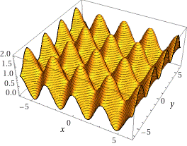
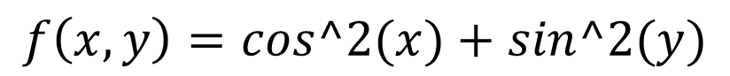
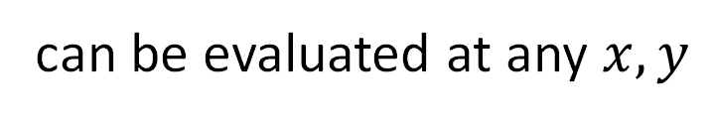
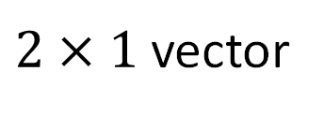
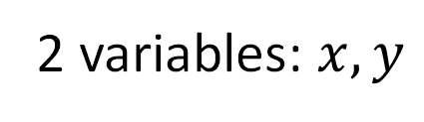
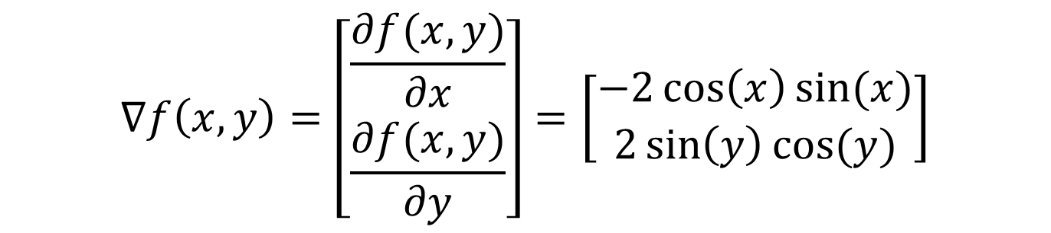
Preliminaries: Gradient
$$f\left(x,y\right)=cos^2(x)+sin^2(y)$$
2 variables: $x, y$
$$∇f\left(x,y\right)=\left[\begin{aligned}\frac{∂f(x,y)}{∂x} \\ \frac{∂f(x,y)}{∂y}\end{aligned}\right]=\left[\begin{aligned}−2\cos\left(x\right)\sin{(x)} \\ 2\sin\left(y\right)\cos{(y)}\end{aligned}\right]$$
can be evaluated at any $x, y$
$2×1$ vector

Slide 63

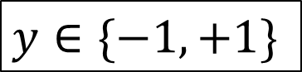
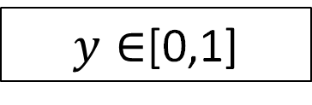
Linear Models for Three Learning Problems
Approve
or Deny
Classification
$$y∈\{−1,+1\}$$
Credit
Analysis
Amount
of Credit
Regression
$$y∈ℝ$$
Probability
of Default
Logistic Regression
$y∈$[0,1]
Fundamental: Building block for more complex models
First model to try!

Slide 64
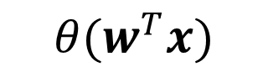
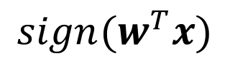

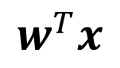
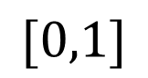

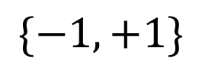
Linear Models: The Linear Signal
$$sign(w^{T}x)$$
$$\{−1,+1\}$$
Classification
$$w^{T}x$$
$$w^{T}x$$
$$ℝ$$
Regression
$$θ(w^{T}x)$$
$$[0,1]$$
Logistic Regression

Slide 65
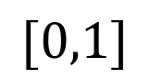

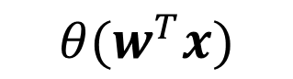

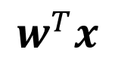
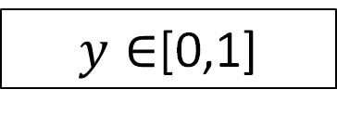
Linear Models for Three Learning Problems
Approve
or Deny
Classification
$$y∈\{−1,+1\}$$
Credit
Analysis
Amount
of Credit
Regression
$$y∈ℝ$$
Probability
of Default
Logistic Regression
$y∈$[0,1]
$$w^{T}x$$
$$θ(w^{T}x)$$
$$[0,1]$$

Slide 66
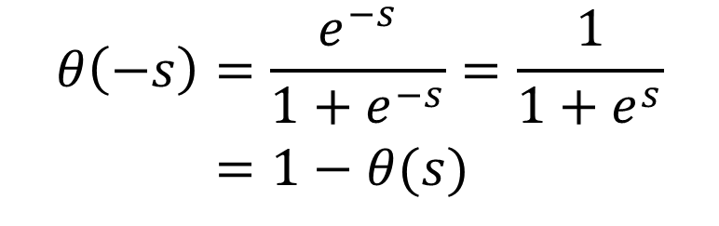
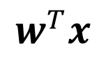
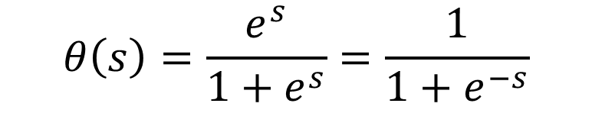
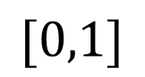
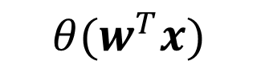
Predicting a Probability Using the Linear Signal
$$w^{T}x$$
$$θ(w^{T}x)$$
$$[0,1]$$
$$θ\left(s\right)=\frac{e^{s}}{1+e^{s}}=\frac{1}{1+e^{−s}}$$
$$θ\left(−s\right)=\frac{e^{−s}}{1+e^{−s}}=\frac{1}{1+e^{s}}$$
$=1−θ(s)$

Slide 67
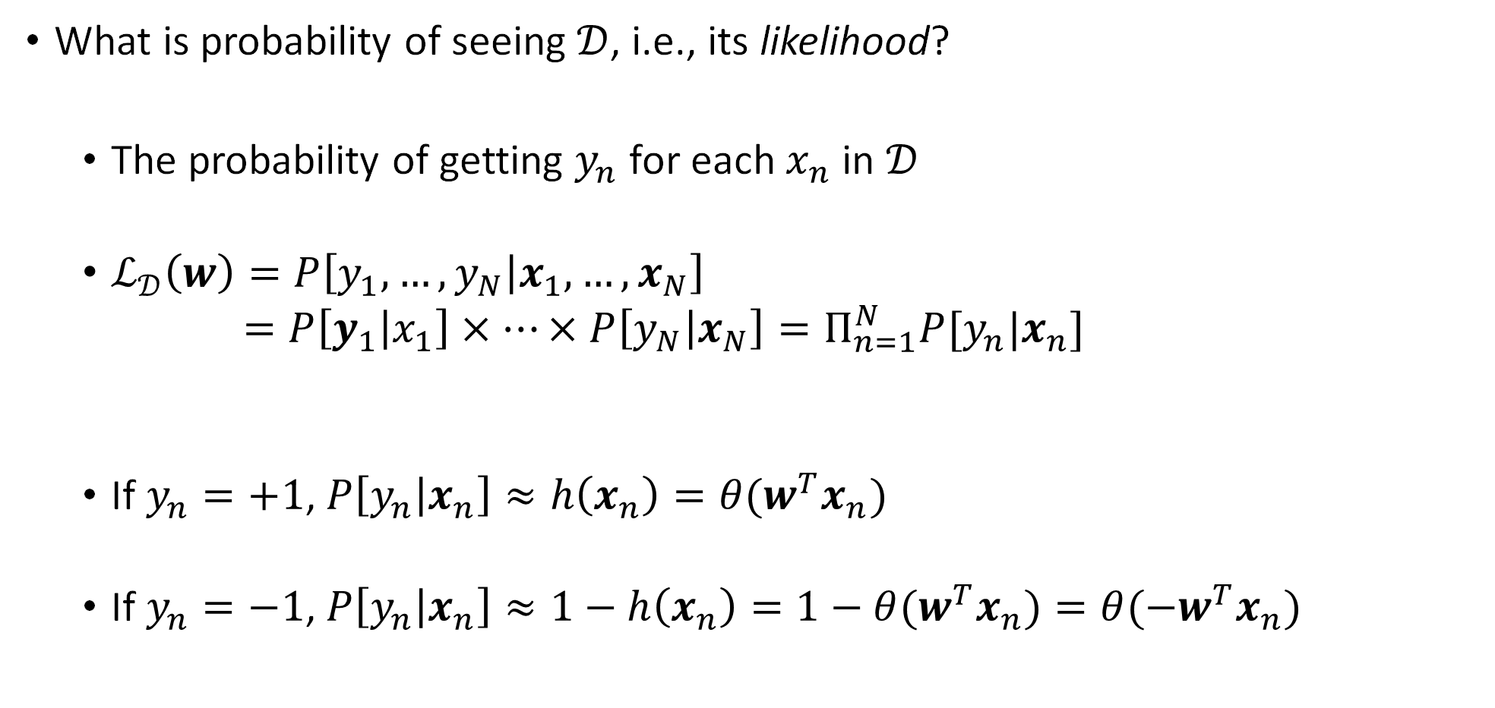
Cross Entropy Error Measure
What is probability of seeing $𝒟$, i.e., its likelihood?
The probability of getting $y_{n}$ for each $x_{n}$ in $𝒟$
$ℒ_{𝒟}\left(w\right)=P\left[y_{1},…,y_{N} | x_{1},…,x_{N}\right]$
$=P\left[y_{1} | x_{1}\right]×…×P\left[y_{N} | x_{N}\right]=Π_{n=1}^{N}P[y_{n}|x_{n}]$
If $y_{n}=+1$, $P\left[y_{n} | x_{n}\right]≈h\left(x_{n}\right)={θ(w}^{T}x_{n})$
If $y_{n}=−1$, $P\left[y_{n} | x_{n}\right]≈1−h\left(x_{n}\right)=1−{θ(w}^{T}x_{n})={θ(−w}^{T}x_{n})$

Slide 68
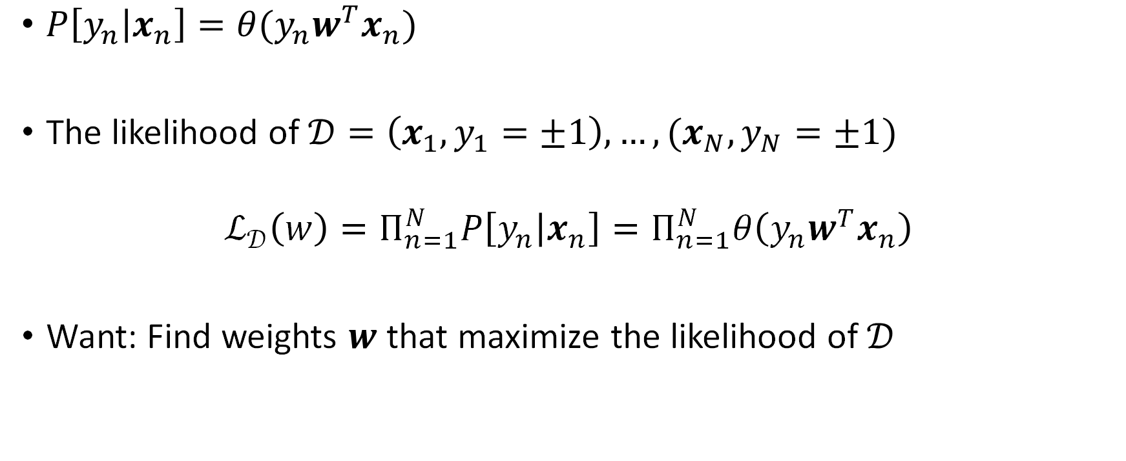
Cross Entropy Error Measure
$P\left[y_{n} | x_{n}\right]=θ(y_{n}w^{T}x_{n})$
The likelihood of $𝒟=\left(x_{1},y_{1}=±1\right),…,(x_{N},y_{N}=±1)$
$$ℒ_{𝒟}\left(w\right)=Π_{n=1}^{N}P\left[y_{n} | x_{n}\right]=Π_{n=1}^{N}θ\left(y_{n}w^{T}x_{n}\right)$$
Want: Find weights $w$ that maximize the likelihood of $𝒟$

Slide 69
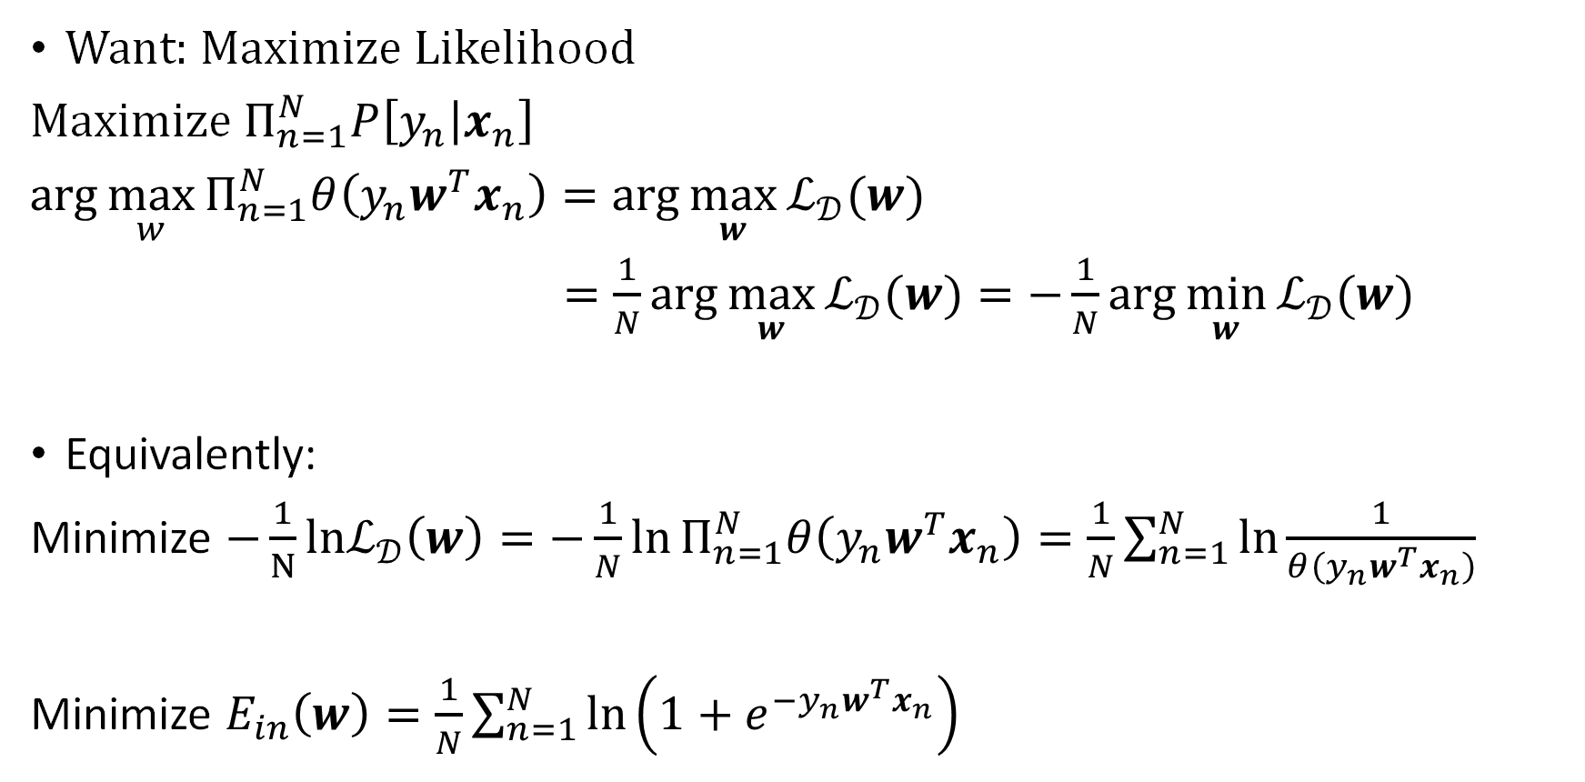
Cross Entropy Error Measure
Want: Maximize Likelihood
Maximize $Π_{n=1}^{N}P\left[y_{n} | x_{n}\right]$
$\arg{\max_{w}{Π_{n=1}^{N}θ\left(y_{n}w^{T}x_{n}\right)}}=\arg{\max_{w}{ℒ_{𝒟}(w)}}$
$=\frac{1}{N}\arg{\max_{w}{ℒ_{𝒟}(w)}}=−\frac{1}{N}\arg{\min_{w}{ℒ_{𝒟}(w)}}$
Equivalently:
Minimize $−\frac{1}{N}lnℒ_{𝒟}\left(w\right)=−\frac{1}{N}\ln{Π_{n=1}^{N}θ\left(y_{n}w^{T}x_{n}\right)}=\frac{1}{N}\sum_{n=1}^{N}{\ln{\frac{1}{θ\left(y_{n}w^{T}x_{n}\right)}}}$
Minimize $E_{in}\left(w\right)=\frac{1}{N}\sum_{n=1}^{N}{\ln\left(1+e^{−y_{n}w^{T}x_{n}}\right)}$

Slide 70
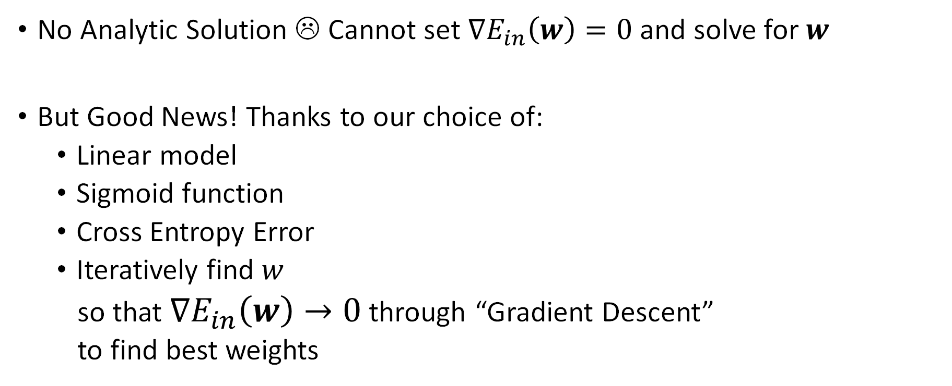
Method of Maximum Likelihood: Minimize Cross Entropy Error
No Analytic Solution ☹ Cannot set $∇E_{in}\left(w\right)=0$ and solve for $w$
But Good News! Thanks to our choice of:
Linear model
Sigmoid function
Cross Entropy Error
Iteratively find $w$
so that $∇E_{in}\left(w\right)→0$ through “Gradient Descent”
to find best weights

Slide 71
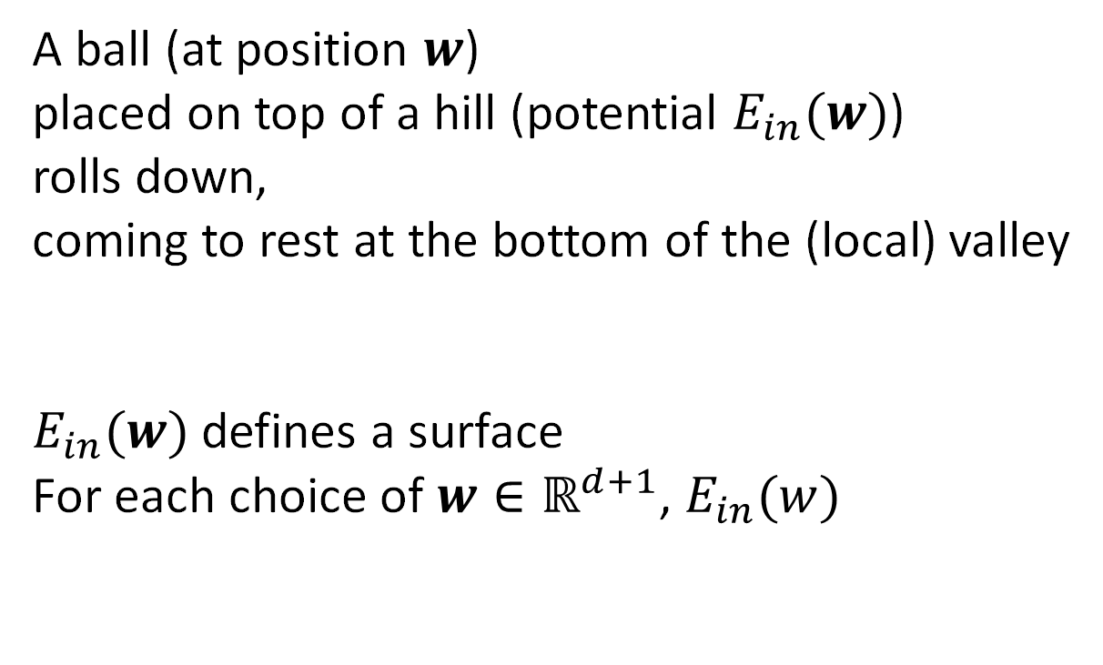
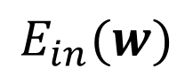

Hill Descent
$$E_{in}(w)$$
A ball (at position $w$)
placed on top of a hill (potential $E_{in}(w)$)
rolls down,
coming to rest at the bottom of the (local) valley
$E_{in}(w)$ defines a surface
For each choice of $w∈ℝ^{d+1}$, $E_{in}(w)$
$$w$$

Slide 72
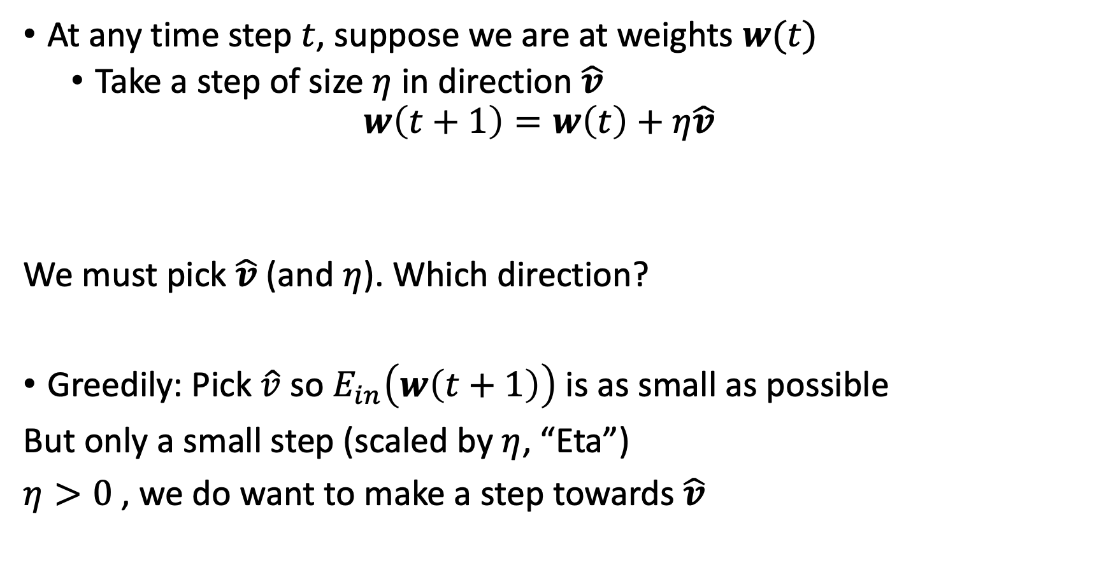
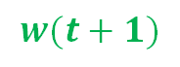
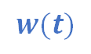


How to Roll Down the Hill?
At any time step $t$, suppose we are at weights $w(t)$
Take a step of size $η$ in direction $\hat{v}$
$$w\left(t+1\right)=w\left(t\right)+η\hat{v}$$
We must pick $\hat{v}$ (and $η$). Which direction?
Greedily: Pick $\hat{v}$ so $E_{in}\left(w\left(t+1\right)\right)$ is as small as possible
But only a small step (scaled by $η$, “Eta”)
$η>0$ , we do want to make a step towards $\hat{v}$
$$w(t+1)$$
$$w(t)$$
$$η\hat{v}$$
$$\hat{v}$$

Slide 73
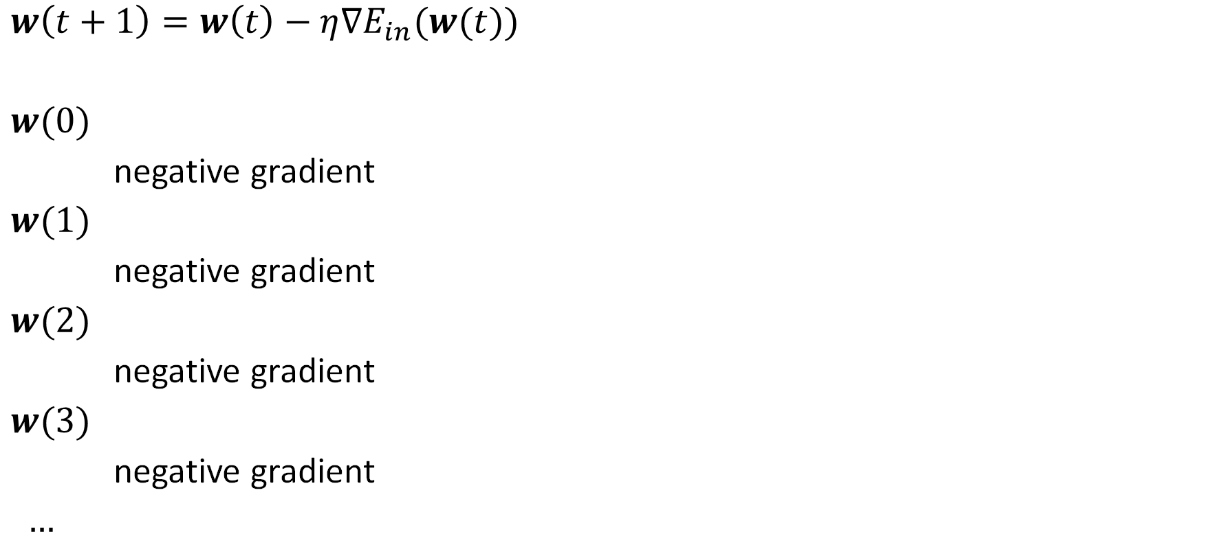

Rolling Down $≡$ Iterating the Negative Gradient
$w\left(t+1\right)=w\left(t\right)−η∇E_{in}(w(t))$
$w(0)$
negative gradient
$w(1)$
negative gradient
$w(2)$
negative gradient
$w(3)$
negative gradient
$…$

Slide 74

Picking the “Learning Rate” $η$

Slide 75
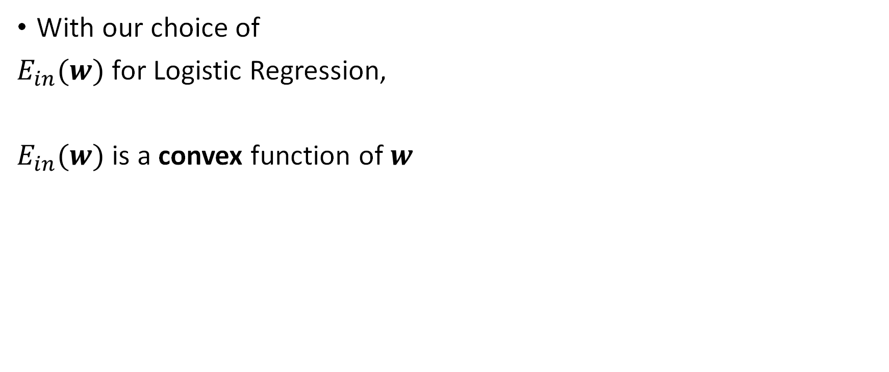
Good News! There is Only One Valley
With our choice of
$E_{in}(w)$ for Logistic Regression,
$E_{in}(w)$ is a convex function of $w$

Slide 76
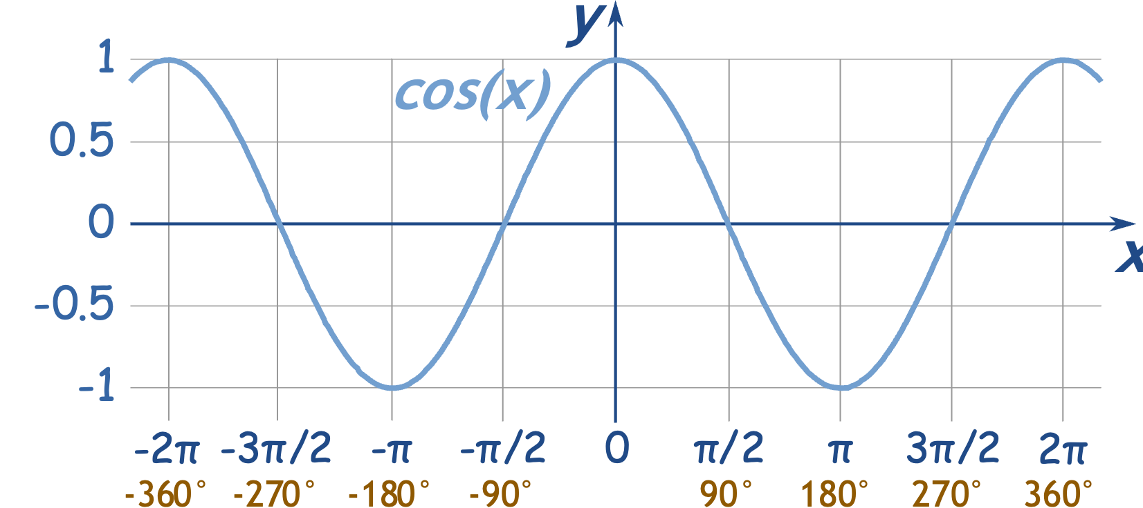

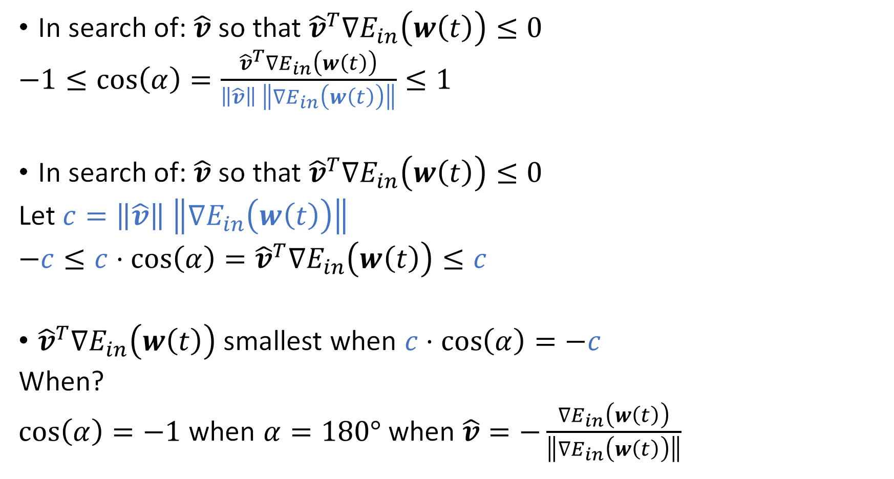
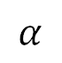
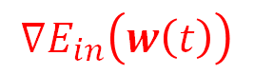
(Is the Gradient)
Fastest Way to Roll Down
$${∇E}_{in}\left(w\left(t\right)\right)$$
In search of: $\hat{v}$ so that ${{\hat{v}}^{T}∇E}_{in}\left(w\left(t\right)\right)≤0$
$−1≤\cos\left(α\right)=\frac{{{\hat{v}}^{T}∇E}_{in}\left(w\left(t\right)\right)}{\left\|\hat{v}\right\| \left\|{∇E}_{in}\left(w\left(t\right)\right)\right\|}≤1$
In search of: $\hat{v}$ so that ${{\hat{v}}^{T}∇E}_{in}\left(w\left(t\right)\right)≤0$
Let $c=\left\|\hat{v}\right\| \left\|{∇E}_{in}\left(w\left(t\right)\right)\right\|$
$−c≤c⋅\cos\left(α\right)={{\hat{v}}^{T}∇E}_{in}\left(w\left(t\right)\right)≤c$
${{\hat{v}}^{T}∇E}_{in}\left(w\left(t\right)\right)$ smallest when $c⋅\cos\left(α\right)=−c$
When?
$\cos\left(α\right)=−1$ when $α=180°$ when $\hat{v}=−\frac{{∇E}_{in}\left(w\left(t\right)\right)}{\left\|{∇E}_{in}\left(w\left(t\right)\right)\right\|}$
$$α$$
$$\hat{v}$$

Slide 77
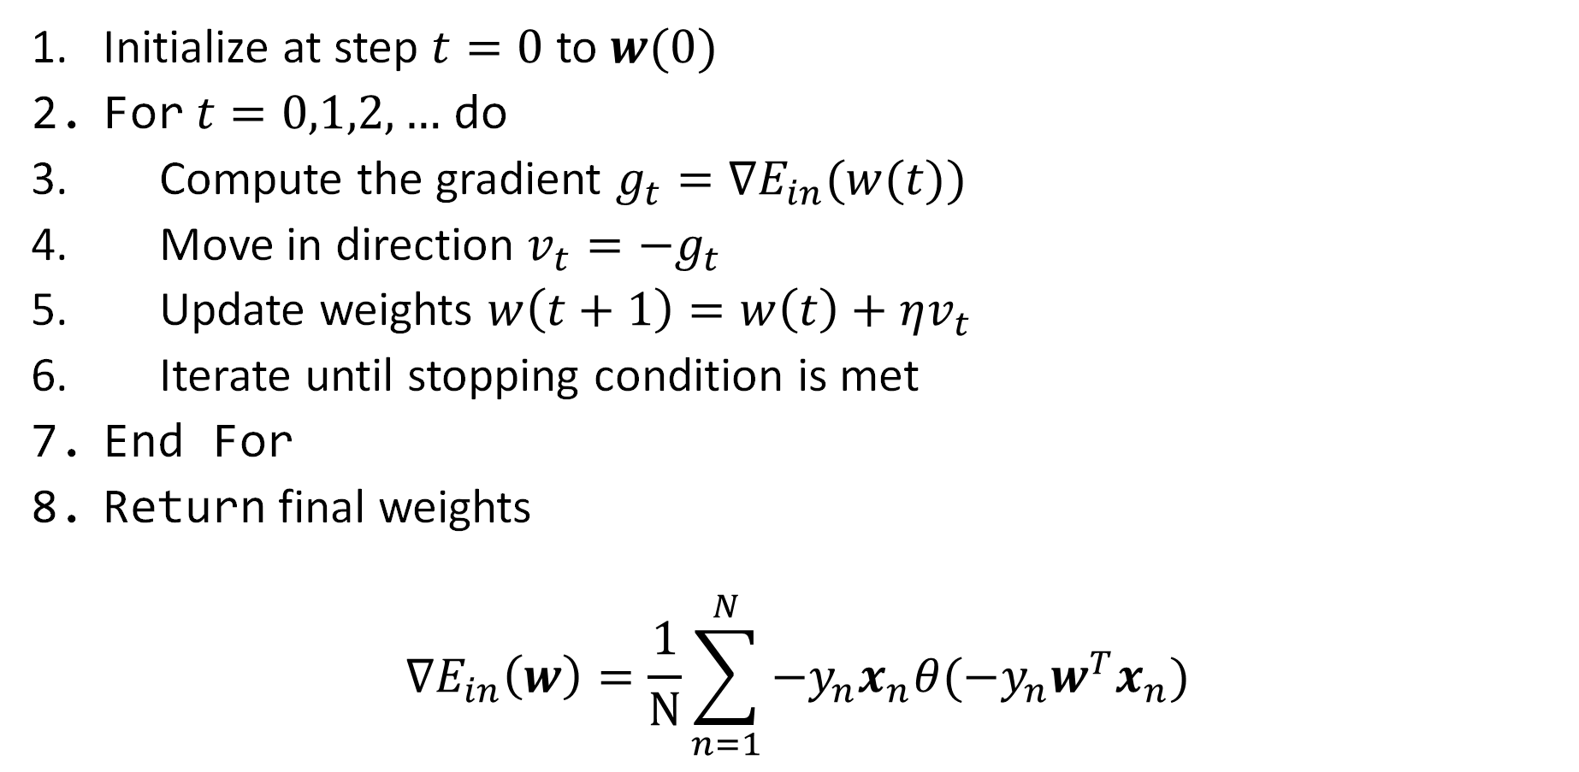
The (fixed learning rate) Gradient Descent Algorithm
Initialize at step $t=0$ to $w(0)$
For $t=0,1,2,…$ do
Compute the gradient $g_{t}=∇E_{in}(w(t))$
Move in direction $v_{t}=−g_{t}$
Update weights $w\left(t+1\right)=w\left(t\right)+ηv_{t}$
Iterate until stopping condition is met
End For
Return final weights
$$∇E_{in}\left(w\right)=\frac{1}{N}\sum_{n=1}^{N}{−y_{n}x_{n}θ(−y_{n}w^{T}x_{n})}$$

Slide 78

The Gradient Descent (GD) Algorithm
Initialize at step $t=0$ to $w(0)$
For $t=0,1,2,…$ do
Compute the gradient $g_{t}=∇E_{in}(w(t))$
Move in direction $v_{t}=−g_{t}$
Update weights $w\left(t+1\right)=w\left(t\right)+ηv_{t}$
Iterate until stopping condition is met
End For
Return final weights
Minimize $E_{in}\left(w\right)=\frac{1}{N}\sum_{n=1}^{N}{\ln\left(1+e^{−y_{n}w^{T}x_{n}}\right)}$
By Moving a small step $−η∇E_{in}\left(w\right)=−η\frac{1}{N}\sum_{n=1}^{N}{−y_{n}x_{n}θ(−y_{n}w^{T}x_{n})}$

Slide 79

Stochastic Gradient Descent (SGD)
Gradient Descent (GD):
Minimize $E_{in}\left(w\right)=\frac{1}{N}\sum_{n=1}^{N}{error(w,x_{n},y_{n})}$
Stochastic Gradient Descent (SGD):
Pick a data point $(x_{∗},y_{∗})$ from $𝒟$ uniformly at random [Stochastic]
Run an iteration of GD on $error(w,x_{∗},y_{∗})$
$$w\left(t+1\right)=w\left(t\right)−η∇error(w,x_{∗},y_{∗})$$
$$𝔼_{𝒟}\left[w(t+1)\right]=w\left(t\right)+\frac{1}{N}\sum_{n=1}^{N}{error(w,x_{n},y_{n})}$$

Slide 80


Stochastic Gradient Descent for Logistic Regression
Logistic Regression:
$$w\left(t+1\right)=w\left(t\right)−η∇error(w(t),x_{∗},y_{∗})$$
$$∇error\left(w,x,y\right)=∇\ln{(1+e^{−yw^{T}x})}$$
$$=\left(\frac{1}{1+e^{−yw^{T}x}}\right)(−yx⋅e^{−yw^{T}x})$$
$$=−yx\left(\frac{e^{−yw^{T}x}}{1+e^{−yw^{T}x}}\right)$$
$$=−yx\left(\frac{1}{1+e^{yw^{T}x}}\right)$$
$$⇒ w\left(t+1\right)=w\left(t\right)+y_{∗}x_{∗}\frac{η}{1+e^{y_{∗}w^{T}x_{∗}}}$$
$$d ln\left(1+s\right)= \frac{1}{1+s}$$
$$d e^{−s}=xe^{−s}$$

Slide 81

SGD for Logistic Regression
$w\left(t\right)+η\frac{1}{N}\sum_{n=1}^{N}{y_{n}x_{n}θ(−y_{n}w^{T}x_{n})}$ $w\left(t\right)+η⋅y_{∗}x_{∗}θ(−y_{∗}w^{T}x_{∗})$

Slide 82

Why Stochastic Gradient Descent?
“Average” move is same as GD
Computational Cost: Each step is less $\left(\frac{1}{N}\right)$ costly
Simple
Stochasticity may help escape local minima
Similar to PLA

Slide 83

Logistic Regression for Classification
$$g\left(x\right)∈\left[0, 1\right]=\hat{Pr}\left(y=+1 \right| x)$$
Use a threshold to decide:
E.g. if $g\left(x\right)≥0.5$, output $+1$
otherwise, output $−1$

Slide 84

Classifier Evaluation Metrics: Confusion Matrix
Confusion Matrix:
In a confusion matrix with $m$ classes, $CM_{i,j}$ indicates # of tuples in class $i$ that were labeled by the classifier as class $j$
May have extra rows/columns to provide totals
Example of Confusion Matrix:
Actual class\Predicted class | C₁ | ¬ C₁
C₁ | True Positives (TP) | False Negatives (FN)
¬ C₁ | False Positives (FP) | True Negatives (TN)
P
N
Actual class\Predicted class | Bat first = yes | Bat first = no | Total
Bat first = yes | 6954 | 46 | 7000
Bat first = no | 412 | 2588 | 3000
Total | 7366 | 2634 | 10000

Slide 85






Tradeoffs between Specificity (TN/N) and Sensitivity (TP/P)
What are their:
TP rate and FP rate?
Sensitivity and Specificity?
Binary classifier $A$ always outputs +1
Binary classifier $B$ always outputs -1
Binary classifier $O$ always predicts correctly
Binary classifier $D$ guesses +1 w/ prob. 0.7
Vertical axis: True Positive rate (TP/P)
Horizontal axis: False Positive rate (FP/N)
1
$$O$$
$$A$$
better
$$(0.7,0.7)$$
$$D$$
TP rate
worse
$$B$$
0
0
FP rate
1

Slide 86

Probabilistic Classifiers Use a Threshold
Naïve Bayes
Logistic Regression
…
Input: data example $x$
Unknown label: $y$ could be either +1 or -1
Output: Predict probability $g(x)$ that the label for $x$ is +1
How to decide?
Use a threshold $σ$: If $g\left(x\right)≥σ$, classify $x$ as +1
Otherwise, classify $x$ as -1
How to set the threshold? How to determine if $g$ is a good classifier?
1
Need more evidence to output +1
Conservative classifier
TP rate
Liberal classifier
0
0
FP rate
1

Slide 87
Model Selection: ROC Curves
ROC (Receiver Operating Characteristics) curves: for visual comparison of classification models
Originated from signal detection theory
Shows the trade-off between the true positive rate and the false positive rate
The area under the ROC curve (AUC: Area Under Curve) is a measure of the accuracy of the model
Rank the test tuples in decreasing order: the one that is most likely to belong to the positive class appears at the top of the list
The closer to the diagonal line (i.e., the closer the area is to 0.5), the less accurate is the model
True positive rate
False positive rate
Vertical axis represents the true positive rate (TP/P)
Horizontal axis rep. the false positive rate (FP/N)
The plot also shows a diagonal line
A model with perfect accuracy will have an area of 1.0

Slide 88


Linear Models for Three Learning Problems
Approve
or Deny
Classification
$$y∈\{−1,+1\}$$
Credit
Analysis
Amount
of Credit
Regression
$$y∈ℝ$$
Probability
of Default
Logistic Regression
$y∈$[0,1]

Slide 89



Towards a more compact representation
Data point
$x=\left[\begin{aligned}x_{0} \\ x_{1} \\ x_{2} \\ … \\ x_{d}\end{aligned}\right]∈{1×ℝ}^{d}$ (i.e. $x_{0}=1$)
$(d+1)×1$
Weights
$$w=\left[\begin{aligned}w_{0} \\ w_{1} \\ w_{2} \\ … \\ w_{d}\end{aligned}\right]∈ℝ^{d+1}$$
$$\left(d+1\right)×1$$
Prediction $\hat{y}=x^{T}w$ $[=w^{T}x]$
$\hat{y}=[x_{0}x_{1}x_{2}…x_{d}]\left[\begin{aligned}w_{0} \\ w_{1} \\ w_{2} \\ … \\ w_{d}\end{aligned}\right]∈ℝ$

Slide 90








Towards a more compact representation
Dataset
Target
Weights
Predictions(in-sample)
$X=\left[\begin{aligned}−x_{1}^{T}− \\ −x_{2}^{T}− \\ … \\ −x_{N}^{T}−\end{aligned}\right]$
$y=\left[\begin{aligned}y_{1} \\ y_{2} \\ … \\ y_{N}\end{aligned}\right]$
$w=\left[\begin{aligned}w \\ w_{2} \\ … \\ w_{d+1}\end{aligned}\right]$
$$\hat{y}=\left[\begin{aligned}{\hat{y}}_{1} \\ {\hat{y}}_{2} \\ … \\ {\hat{y}}_{N}\end{aligned}\right]=\left[\begin{aligned}x_{1}^{T}w \\ x_{2}^{T}w \\ … \\ x_{N}^{T}w\end{aligned}\right]=Xw$$
$N×(d+1)$
$N×1$
$(d+1)×1$
$N×1$

Slide 91



Using Matrices for Linear Regression
$X=\left[\begin{aligned}−x_{1}^{T}− \\ −x_{2}^{T}− \\ … \\ −x_{N}^{T}−\end{aligned}\right]$ $y=\left[\begin{aligned}y_{1} \\ y_{2} \\ … \\ y_{N}\end{aligned}\right]$ $\hat{y}=\left[\begin{aligned}{\hat{y}}_{1} \\ {\hat{y}}_{2} \\ … \\ {\hat{y}}_{N}\end{aligned}\right]=\left[\begin{aligned}x_{1}^{T}w \\ x_{2}^{T}w \\ … \\ x_{N}^{T}w\end{aligned}\right]=Xw$
$N×(d+1)$ $N×1$ $N×1$
data matrix target vector in-sample predictions
$E_{in}\left(w\right)=\frac{1}{N}\sum_{n=1}^{N}{{\left({\hat{y}}_{n}−y_{n}\right)}^{2}}$
$=\frac{1}{N}{\left\|\hat{y}−y\right\|}_{2}^{2}$
$=\frac{1}{N}{\left\|Xw−y\right\|}_{2}^{2}$
$=\frac{1}{N}\left(w^{T}X^{T}Xw−2w^{T}X^{T}y+y^{T}y\right)$
Want: $w_{lin}=\arg{\min_{w∈ℝ^{d+1}}{E_{in}(w)}}$
${\left\|⋅\right\|}_{2}$ is the Euclidean norm
for any $k×1$ vector $z=\left[\begin{aligned}z_{1} \\ … \\ z_{k}\end{aligned}\right]$,
$${\left\|z\right\|}_{2}=\sqrt{z_{1}^{2}+…+z_{k}^{2}}$$
$${\left\|z\right\|}_{2}^{2}=z^{T}z$$
$${\left(U−V\right)}^{T}=U^{T}−V^{T}$$
$${\left(UV\right)}^{T}=V^{T}U^{T}$$

Slide 92



Ordinary Least Squares: Minimizing $E_{in}$
$E_{in}\left(w\right)=\frac{1}{N}\left(w^{T}X^{T}Xw−2w^{T}X^{T}y+y^{T}y\right)$
Input data set $X$, target values on input data set $y$ are fixed
Intermediate Goal: $w_{lin}=\arg{\min_{w∈ℝ^{d+1}}{E_{in}(w)}}$
Set derivative $∇E_{in}\left(w\right)=0$
[using matrix calculus]
[Differentiable]
Similar to standard calculus
Want:
$$z^{∗}=\arg{\min_{z}{f\left(z\right)=az^{2}+bz+c}}$$
Set $\frac{df}{dz}=2az+b=0$
$⇒$ $z^{∗}=−\frac{b}{2a}$

Slide 93



Ordinary Least Squares: Minimizing $E_{in}$
$E_{in}\left(w\right)=\frac{1}{N}\left(w^{T}X^{T}Xw−2w^{T}X^{T}y+y^{T}y\right)$ Differentiable
$∇E_{in}(w)$ is a $(d+1)$ – vector
${\left[∇E_{in}\left(w\right)\right]}_{i}=\frac{∂}{∂w_{i}}E_{in}\left(w\right)$ is the $i$-th component
$∇_{w}E_{in}\left(w\right)=\frac{2}{N}(X^{T}Xw−X^{T}y)$
$=0$
Solve for $w$: $X^{T}Xw=X^{T}y$
Similar to standard calculus
Want:
$$z^{∗}=\arg{\min_{z}{f\left(z\right)=az^{2}+bz+c}}$$
Set $\frac{df}{dz}=2az+b=0$
$⇒$ $z^{∗}=−\frac{b}{2a}$
Useful gradient identities:
$∇_{z}\left(z^{T}Az\right)=\left(A+A^{T}\right)z$
$∇_{z}\left(z^{T}b\right)=b$

Slide 94


Ordinary Least Squares: Minimizing $E_{in}$
Ordinary Least Squares Algorithm: Solve for $w$: $X^{T}Xw=X^{T}y$
Input: $\left(x_{1},y_{1}\right), \left(x_{2},y_{2}\right), …, (x_{n},y_{n})$
Construct matrix $X=\left[\begin{aligned}−x_{1}^{T}− \\ −x_{2}^{T}− \\ … \\ −x_{N}^{T}−\end{aligned}\right]$, $y=\left[\begin{aligned}y_{1} \\ y_{2} \\ … \\ y_{N}\end{aligned}\right]$
Compute pseudo-inverse $X^{†}$ of $X$
If $X^{T}X$ is invertible, $X^{†}={\left(X^{T}X\right)}^{−1}X^{T}$
Return $w_{lin}=X^{†}y$
Analytical Solution!
$$O(Nd^{2}+d^{3})$$

Slide 95
Digits Data
Each example of a digit is a $16×16$ image
http://yann.lecun.com/exdb/mnist/

Slide 96
Digits Data
[-1 -1 -1 -1 -1 -1 -1 -0.63 0.86 -0.17 -1 -1 -1 -1 -1 -1 -1 -1 -1 -1 -1 -1 -0.99 0.3 1 0.31 -1 -1 -1 -1 -1 -1 -1 -1 -1 -1 -1 -1 -0.41 1 0.99 -0.57 -1 -1 -1 -1 -1 -1 -1 -1 -1 -1 -1 -0.68 0.83 1 0.56 -1 -1 -1 -1 -1 -1 -1 -1 -1 -1 -1 -0.94 0.54 1 0.78 -0.72 -1 -1 -1 -1 -1 -1 -1 -1 -1 -1 -1 0.1 1 0.92 -0.44 -1 -1 -1 -1 -1 -1 -1 -1 -1 -1 -1 -0.26 0.95 1 -0.16 -1 -1 -1 -0.99 -0.71 -0.83 -1 -1 -1 -1 -1 -0.8 0.91 1 0.3 -0.96 -1 -1 -0.55 0.49 1 0.88 0.09 -1 -1 -1 -1 0.28 1 0.88 -0.8 -1 -0.9 0.14 0.97 1 1 1 0.99 -0.74 -1 -1 -0.95 0.84 1 0.32 -1 -1 0.35 1 0.65 -0.10 -0.18 1 0.98 -0.72 -1 -1 -0.63 1 1 0.07 -0.92 0.11 0.96 0.30 -0.88 -1 -0.07 1 0.64 -0.99 -1 -1 -0.67 1 1 0.75 0.34 1 0.70 -0.94 -1 -1 0.54 1 0.02 -1 -1 -1 -0.90 0.79 1 1 1 1 0.53 0.18 0.81 0.83 0.97 0.86 -0.63 -1 -1 -1 -1 -0.45 0.82 1 1 1 1 1 1 1 1 0.13 -1 -1 -1 -1 -1 -1 -0.48 0.81 1 1 1 1 1 1 0.21 -0.94 -1 -1 -1 -1 -1 -1 -1 -0.97 -0.42 0.30 0.82 1 0.48 -0.47 -0.99 -1 -1 -1 -1]
$x=(1,x_{1},…,x_{256})$
$w=\left(w_{0},w_{1},…, w_{256}\right)$
$$d_{VC}=257$$

Slide 97

Features: Intensity and Symmetry
Human-like approach: Summarize image by a few features
feature: an important property of the input you think is useful for classification
symmetry
intensity

Slide 98


Perceptron Model on Digits Data
PLA
Pocket Algorithm

Slide 99
Flashback: VC Analysis, Approximation vs. Generalization
out of sample error
$E_{out}(g)$
Error
model complexity
in sample error
$E_{in}(g)$
$$d_{VC}^{∗}$$
$$d_{VC}$$
$d_{VC}↑ ⇒E_{in}≈0$: Higher chance of approximating target function on data
$d_{VC}↓⇒E_{in}≈E_{out}$: Higher chance of generalizing to out of data
Depends only on $ℋ$; Independent of $f, P(x), 𝒜$ (the learning algorithm)

Slide 100
Bias – Variance Analysis
An alternate view of the approximation-generalization tradeoff
for squared error measures (e.g. regression)
How well can a hypothesis in $ℋ$ approximate $f$?
How close can we get to this using a finite dataset?

Slide 101
Bias-Variance Tradeoff
bias: How well can $ℋ$ fit target $f$?
var: How often can we find a good approximation?
small bias
Large $ℋ$
$$f$$
$$f$$
large
$$bias$$
large $var$
Small $ℋ$
small var

Slide 102
A Simple Learning Problem $f\left(x\right)=\sin{πx}$
2 Data points
2 Hypothesis sets:
Flat lines $ℋ_{0}: h\left(x\right)=b$ All lines $ℋ_{1}: h\left(x\right)=ax+b$
$$y$$
$$y$$
$$x$$
$$x$$

Slide 103
A Simple Learning Problem $f\left(x\right)=\sin{πx}$
Flat lines $ℋ_{0}: h\left(x\right)=b$ All lines $ℋ_{1}: h\left(x\right)=ax+b$
$$error={\left(g\left(x\right)−f\left(x\right)\right)}^{2}$$
$$y$$
$$y$$
$$f(x)$$
$$x$$
$$x$$
g$(x)$
$$x$$
$$x$$

Slide 104
A Simple Learning Problem $f\left(x\right)=\sin{πx}$
2 Data points
2 Hypothesis sets:
Flat lines $ℋ_{0}: h\left(x\right)=b$ All lines $ℋ_{1}: h\left(x\right)=ax+b$
$$y$$
$$y$$
$$x$$
$$x$$

Slide 105
A Simple Learning Problem $f\left(x\right)=\sin{πx}$
Flat lines $ℋ_{0}: h\left(x\right)=b$ All lines $ℋ_{1}: h\left(x\right)=ax+b$
$$error={\left(g\left(x\right)−f\left(x\right)\right)}^{2}$$
$$y$$
$$y$$
$$f(x)$$
$$x$$
$$x$$
$$x$$
g$(x)$
$$x$$
$$x$$

Slide 106
Different Dataset $𝒟$, Different Output $g^{𝒟}$
For a fixed test point $x$,
$g^{𝒟}(x)$ is a random value that depends on $𝒟$
$$y$$
$$y$$
$$x$$
$$x$$
$$x$$
$$x$$

Slide 107
We can’t pick our data set!
We must analyze the entire process:
Sample a data set
Fit it (pick $g$ from $ℋ$ using $𝒜$)
Measure $E_{in}$
$$y$$
$$y$$
$$x$$
$$x$$
$$x$$
$$x$$

Slide 108
$E_{out}$: Average over $x$
$$E_{out}=𝔼_{x}\left[𝔼_{𝒟}\left[{\left(g^{𝒟}\left(x\right)−f\left(x\right)\right)}^{2}\right]\right]=𝔼_{x}\left[{\left(\overline{g}\left(x\right)−f\left(x\right)\right)}^{2}+var\left(x\right)\right]$$
$=𝔼_{x}[bias\left(x\right)+var(x)]$
$=$ $bias + var$
generalization
How close is average
learned hypothesis to
target function?
approximation
How often can we find a good hypothesis?

Slide 109
Bias-Variance Tradeoff
bias: How well can $ℋ$ fit target $f$?
var: How often can we find a good approximation?
small bias
Large $ℋ$
$$f$$
$$f$$
large
$$bias$$
large $var$
Small $ℋ$
small var

Slide 110


Match Learning Power to Data, Not the Target $f$
2 Data points
5 Data points
$$ℋ_{0}$$
$bias=0.5$
$var=0.25$
$E_{out}=0.75$
$$ℋ_{1}$$
$bias=0.21$
$var=1.69$
$E_{out}=1.90$
$$ℋ_{0}$$
$bias=0.5$
$var=0.1$
$E_{out}=0.6$
$$ℋ_{1}$$
$bias=0.21$
$var=0.21$
$E_{out}=0.42$

Slide 111
Bias-Variance Analysis: A Useful Conceptual Tool
Depends on $f$, $P(x)$ – both unknown
Depends on $𝒜$
The objective of $𝒜$ is to minimize squared error
But for Bias-Variance analysis, we will use the squared error of $g$ selected by $𝒜$
Developing a model:
Lower variance without increasing bias
Lower bias without increasing variance
Techniques discussed later in this course

Slide 112



But: The Linear Model has Limitations
Linear with Outliers
Essentially Non-linear
Need something non-linear
Please remember these two scenarios for later

Slide 113
Changing the Feature Using a Transform
Income
$$Y\underset{→}{Φ}Z$$
Income
Years in Residence ($Y$)
$$Z$$

Slide 114


Mechanics of Non-Linear Feature Transforms
$$𝒳$$
$$𝒵$$
$$Φ$$
$$x_{2}$$
$$z_{2}=x_{2}^{2}$$
$0$,0
$$sign(w^{T}z)$$
$$x_{1}$$
$$z_{1}=x_{1}^{2}$$
$$z=\left[\begin{aligned}1 \\ z_{1} \\ z_{2}\end{aligned}\right]=\left[\begin{aligned}1 \\ Φ(x_{1}) \\ Φ(x_{2})\end{aligned}\right]=\left[\begin{aligned}1 \\ x_{1}^{2} \\ x_{2}^{2}\end{aligned}\right]$$
$$x=\left[\begin{aligned}1 \\ x_{1} \\ x_{2}\end{aligned}\right]$$
$$Φ$$

Slide 115
Possibly Many ‘Good’ Nonlinear Transforms
$$x_{1}^{2}+x_{2}^{2}=0.6$$
$$z_{2}=x_{2}^{2}$$
$$x_{2}$$
$$z_{1}=x_{1}^{2}$$
$$x_{1}$$
$$z_{2}=x_{2}^{2}$$
$$z_{1}=x_{1}^{2}+x_{2}^{2}−0.6$$
$$z_{1}={\left(x_{1}+0.5\right)}^{2}$$

Slide 116
Polynomial Feature Transform
E.g. Polynomial Transform for 2-D $𝒳$-space
Degree 1: $\left(1,x_{1},x_{2}\right)\underset{→}{Φ_{1}} \left(1,x_{1},x_{2}\right) ⇒{\tilde{d}}_{VC}=3$
Degree 2: $\underset{→}{Φ_{2}} \left(1,x_{1},x_{2},x_{1}^{2},x_{1}x_{2},x_{2}^{2}\right) ⇒{\tilde{d}}_{VC}=6$
Degree 3: $\underset{→}{Φ_{3}} \left(1,x_{1},x_{2},x_{1}^{2},x_{1}x_{2},x_{2}^{2},x_{1}^{3},x_{1}^{2}x_{2},x_{1}x_{2}^{2},x_{2}^{3}\right) ⇒{\tilde{d}}_{VC}=10$
Degree 4: $\underset{→}{Φ_{4}} \left(1,x_{1},x_{2},x_{1}^{2},…,x_{2}^{2},x_{1}^{3},…,x_{2}^{3},x_{1}^{4},…,x_{2}^{4}\right) ⇒{\tilde{d}}_{VC}=15$
In general:
For a Q-th order polynomial feature transform, with original $x$ of $d$ dimensions,
$$\tilde{d}=\left({Q+d \atop Q}\right)−1⇒{\tilde{d}}_{VC}=\left({Q+d \atop Q}\right)$$

Slide 117


Use Feature Transforms Responsibly
Approximation – Generalization Tradeoff
$$Q=1$$
$$Q=4$$

Slide 118



Use the Linear Model!
Try it first – simple, robust, works
Works for different kinds of problems:
Classification, Regression, Logistic Regression
Works for nonlinear targets:
All the machinery and algorithms
Can tolerate errors
Easily extended to use nonlinear transforms
Pick feature transform before seeing the data
Linear Model is Fundamental!
Building block for more complex models

Slide 119
Overfitting

Slide 120
Overfitting: When Lower $E_{in}$ results in Higher $E_{out}$
Lowering $E_{in}$ is no longer a good guide to lower $E_{out}$

Slide 121


The Curious Case of the Simple Model 2nd order vs. 10th Order Polynomial Fit
Two Learning Problems
Simple Noisy Target
Complex Noiseless Target

Slide 122
Two Contenders: 2nd Order vs 10th Order Polynomial
$ℋ_{2}:h\left(x\right)=w^{T}Φ_{2}\left(x\right)$
Learn linear model with 2nd order polynomial transform
$ℋ_{10}:h\left(x\right)=w^{T}Φ_{10}\left(x\right)$
Learn linear model with 10th order polynomial transform

Slide 123





2nd Order vs 10th Order Polynomial
simple noisy target
2nd order 10th order
$E_{in}$ | $0.050$ $0.034$
$E_{out}$ | $0.127$ $9.00$
complex noiseless target
2nd order 10th order
$E_{in}$ | $0.029$ ${10}^{−5}$
$E_{out}$ | $0.120$ 7680
Small $N$

Slide 124


When is $ℋ_{2}$ better than $ℋ_{10}$?
Learning curves for $ℋ_{2}$
Learning curves for $ℋ_{10}$
Expected Error
Expected Error
Number of Data Points, $N$
Number of Data Points, $N$
$ℋ$ should match quantity ($N$) and quality of data (noise), not the target ($f$)
Overfitting: When $E_{out}\left(ℋ_{10}\right)>E_{out}(ℋ_{2})$

Slide 125



Overfit Measure: $E_{out}\left(ℋ_{10}\right)−E_{out}(ℋ_{2})$
$${E_{out}(ℋ}_{10})>E_{out}(ℋ_{2})$$
$${E_{out}(ℋ}_{2})>E_{out}(ℋ_{10})$$
Noise level $σ^{2}$ (variance) $↑$
Target complexity $Q_{f}$ $↑$
Number of Data Points $N$ $↑$
$↑$Overfitting
$↑$ Overfitting
$↓$ Overfitting

Slide 126
Stochastic Noise: A Part of $y$ we cannot model
Want to learn from o: $y=f(x)$
Unfortunately we only observe o:
$y=f\left(x\right)+$ stochastic noise
We have no way to model stochastic noise

Slide 127
Stochastic Noise: A Part of $y$ we cannot model
Want to learn from o: $y=f(x)$
Unfortunately we only observe o:
$y=f\left(x\right)+$ stochastic noise
We have no way to model stochastic noise
$$f\left(x\right)+stochastic noise$$
$$h^{∗}∈ℋ$$
$$g∈ℋ$$
$↑$Overfitting
Noise level $σ^{2}$ (variance) $↑$

Slide 128
Deterministic Noise
$$f$$
$$h^{∗}$$
$$y$$
$$h^{∗}∈ℋ$$
$$var$$
det. noise
$$y=f(x)$$
$$x$$

Slide 129

Deterministic Noise: Model Error
Want: Pick $h^{∗}$
the best approximation of $f$ in $ℋ$
Want: To learn from o
Unfortunately, we observe o
$y_{n}=f(x_{n})$
$y_{n}=h^{∗}\left(x_{n}\right)+$ deterministic noise
Target complexity $Q_{f}$ $↑$
$↑$Overfitting

Slide 130


Stochastic and Deterministic Noise Hurt Learning
Stochastic Noise
random measurement errors
Measuring $y_{n}$ again
stochastic noise changes
Independent of $ℋ$
Deterministic Noise
$ℋ$ cannot model $f$
Measuring $y_{n}$ again
deterministic noise constant
Depends on $ℋ$

Slide 131
Bias Variance Decomposition with Stochastic Noise
$E_{out} (x) = {\left(g\left(x\right)−f\left(x\right)\right)}^{2}−2ε\left(g\left(x\right)−f\left(x\right)\right)+ε^{2}$
$𝔼_{x}\left[E_{out}\right] =𝔼_{x}\left[{\left(g\left(x\right)−f\left(x\right)\right)}^{2}−2ε\left(g\left(x\right)−f\left(x\right)\right)+ε^{2}\right]$
$𝔼\left[ε\right]=0$ $⇒$
$$𝔼_{x}\left[E_{out}\right] =𝔼_{x}\left[{\left(g\left(x\right)−f\left(x\right)\right)}^{2}\right]+𝔼_{x}\left[ε^{2}\right]$$
$𝔼_{x}\left[E_{out}\right] =𝔼_{x}\left[bias\left(x\right) +var\left(x\right) +ε^{2}\right]$
$E_{out} = bias + σ^{2} + var$
depends on $N$
det. noise
stoch. noise
indirect impact of noise

Slide 132
Regularization A cure for overfitting
$$E_{out}\left(h\right)≤E_{in}\left(h\right)+Ω(ℋ)$$

Slide 133


Regularization: Constrain the search
Target $f$ is quadratic
5 data points $x_{1},x_{2},…,x_{5}$
A little noise (small measurement error)
Model is 4th order polynomials
($Q=4$)

Slide 134
${Minimize}_{h∈ℋ}$ $E_{in}(h)+Ω(h)$
Constrain the search for $h$ with best fit to data (lowest $E_{in}$)
By adding a penalty for the complexity of the hypothesis ($Ω(h)$)
$Ω(h)$: a measure of the complexity of $h$
‘Weight decay’ works well for the linear model
E.g. Sum of squared weights

Slide 135


The bias-variance decomposition Side effect of regularization: Bias increases
Without regularization
With regularization
Bias: 0.21
Variance: 1.69
Bias: 0.23
Variance: 0.33

Slide 136
Polynomials of Order $Q$: $ℋ_{Q}$
Standard polynomial:
$z=\left[\begin{aligned}1 \\ x \\ x^{2} \\ … \\ x^{Q}\end{aligned}\right]$
$h\left(x\right)=w^{T}z(x)$
$=w_{0}+w_{1}x+…w_{Q}x^{Q}$
Legendre Polynomial:
$z=\left[\begin{aligned}1 \\ L_{1}\left(x\right) \\ L_{2}\left(x\right) \\ … \\ L_{Q}(x)\end{aligned}\right]$
$h\left(x\right)=w^{T}z(x)$
$=w_{0}+w_{1}L_{1}\left(x\right)+…+w_{Q}L_{Q}(x)$

Slide 137

Legendre Polynomial

Slide 138
Polynomial Transforms
$ℋ_{Q}=\left\{h| h\left(x\right)=w^{T}z=\sum_{q=1}^{Q}{w_{q}L_{q}}(x)\right\}$
$ℋ_{10}=\left\{h | h\left(x\right)=w_{0}+w_{1}L_{1}\left(x\right)+w_{2}L_{2}\left(x\right)+w_{3}L_{3}\left(x\right)+…+w_{10}L_{10}\left(x\right)\right\}$
$$ℋ_{2}=\{h|h\left(x\right)=w_{0}+w_{1}L_{1}\left(x\right)+w_{2}L_{2}\left(x\right)+w_{3}L_{3}\left(x\right)+…+w_{10}L_{10}(x)\}$$
where $w_{3},w_{4},…,w_{10}=0$
$ℋ_{2}⊂ℋ_{10}$: Just a constrained version of $ℋ_{10}$
If $E_{in}(ℋ_{2})≈E_{in}(ℋ_{10})$, then choose the output from $ℋ_{2}$

Slide 139
Fitting Optimal Weights Under Budget Constraints
Want: Optimal weights $w_{reg}∈ℋ_{C}$
Smallest $E_{in}$
Under the budget constraint
$w_{reg}∈$
$\arg{\min_{w}{E_{in}(w)}}$ $=\frac{1}{N}{\left(Zw−y\right)}^{T}\left(Zw−y\right)$
subject to:
$w^{T}w≤C$ [soft order budget constraint]
$$≡$$
$$\arg{\min_{w}{E_{aug}\left(w\right)=E_{in}\left(w\right)+λ_{C}w^{T}w}}$$
Set $∇E_{aug}\left(w\right)=0$
$$w_{reg}={\left(Z^{T}Z+λI\right)}^{−1}Z^{T}y$$
$λ$ allows us to control the amount of regularization

Slide 140
Dose Regularization Approporiately
Minimizing $E_{in}\left(w\right)+\frac{λ}{N}w^{T}w$
Overfitting
Underfitting

Slide 141

Overfitting and Underfitting

Slide 142
More Noise Demands More Regularization
Stochastic noise
Deterministic noise

Slide 143
Dose Regularization Appropriately
Pick $h∈ℋ$ which minimizes $E_{aug}\left(h\right)=E_{in}\left(h\right)+\frac{λ}{N}Ω(h)$
Pick $w$ which minimizes $E_{in}\left(w\right)+\frac{λ}{N}w^{T}w$
Overfitting
Underfitting

Slide 144
Overfitting and Underfitting

Slide 145
How to Pick $λ$? Validation: Estimate $E_{out}$
Goal of Learning: Pick $g$ which minimizes $E_{out}(g)$
$$E_{out}\left(g\right)=E_{in}\left(g\right)+model complexity penalty$$
Regularization: Use $λ$ to control the penalty for model complexity
How to pick $λ$?
Estimate $E_{out}\left(g\right)$ ‘directly’
VC analysis bounds penalty by $Ω(ℋ)$
Regularization uses heuristic estimate $Ω(g)$

Slide 146
Estimating $E_{out}(g)$: Using a Test Set
$$P(x)$$
$$x_{1},x_{2},…,x_{N}$$
$$x_{1},x_{2},…,x_{K}$$
TRAINING EXAMPLES $𝒟$
$$\left(x_{1},y_{1}\right), \left(x_{2},y_{2}\right), …,(x_{N},y_{N})$$
TEST EXAMPLES $𝒟_{test}$
$$\left(x_{1},y_{1}\right), \left(x_{2},y_{2}\right), …,(x_{K},y_{K})$$
FINAL HYPOTHESIS
$$g$$
$$e_{k}=error\left(g\left(x_{k}\right),f\left(x_{k}\right)\right)$$
$$e_{1},e_{2},…,e_{K}$$
$$E_{test}\left(g\right)=\frac{1}{K}\sum_{k=1}^{K}{e_{k}}$$
$$E_{out}(g)$$
$$𝔼_{𝒟_{test}}\left[E_{test}\left(g\right)\right]=𝔼\left[\frac{1}{k}\sum_{k=1}^{K}{e_{k}}\right]$$

Slide 147
Estimating $E_{out}(g)$ using a Test Set
$𝔼\left[E_{test}\left(g\right)\right]=E_{out}(g)$
$Var\left[E_{test}\left(g\right)\right]=\frac{1}{K}Var[error(g(x),f(x))]$
Relationship between $E_{test}\left(g\right)$ and $E_{out}(g)$ for a single hypothesis
Using Hoeffding’s inequality: $E_{out}\left(g\right)≤E_{test}\left(g\right)+O\left(\frac{1}{\sqrt{K}}\right)$
$E_{out}\left(g\right)≈E_{test}\left(g\right)±\frac{1}{\sqrt{K}}\sqrt{Var[error(g(x),f(x))]}$
Larger $K$ (size of $𝒟_{test}$) $→$ $E_{test}(g)$ better estimate for $E_{out}(g)$

Slide 148
The Validation Set $𝒟_{val}$: Because $𝒟_{test}$ is unknown
$𝒟_{test}$ is held by the customer. Not available during learning
How to estimate $E_{out}$? How to pick $λ$?
Hold-out a subset of training examples
Partition input dataset $𝒟=\{\left(x_{1},y_{1}\right), \left(x_{2},y_{2}\right), …,\left(x_{N},y_{N}\right)\}$
into two data sets:
$𝒟_{val}$ with $K$ examples chosen from $𝒟$ i.i.d. uniformly at random
$𝒟_{train}$ with $N−K$ remaining examples

Slide 149
Estimating $E_{out}(g)$: Using a Validation Set
$$P(x)$$
$$x_{1},x_{2},…,x_{N}$$
$$𝒟$$
$$𝒟_{train}$$
($N−K$ training points)
$$𝒟_{val}$$
($K$ validation points)
Partition $𝒟={𝒟_{val}∪𝒟}_{train}$
Learn using $𝒟_{train}$ $→$ $g^{−}$
Pick $g^{−}$ from $ℋ$ using $𝒜$
Evaluate $g^{−}$ on $𝒟_{val}$ $→$ $E_{val}(g)$
$𝔼\left[E_{val}\left(g^{−}\right)\right]=E_{out}(g^{−})$
$Var\left[E_{val}\left(g^{−}\right)\right]=\frac{1}{K}Var[error(g^{−},f)]$
LEARN
$$g^{−}$$
$$e_{k}=error\left(g\left(x_{k}\right),f\left(x_{k}\right)\right)$$
$$e_{1},e_{2},…,e_{K}$$
$$E_{val}\left(g\right)=\frac{1}{K}\sum_{k=1}^{K}{e_{k}}$$
$$E_{out}(g^{−})$$

Slide 150
But There is a Price to Pay
$E_{out}\left(g\right)=E_{val}\left(g\right)+O\left(\frac{1}{\sqrt{K}}\right)$
Larger $K$ $⇒$ Better estimate of $E_{out}$
Larger $K$ $⇒$ Fewer data points for training
$⇒$ $E_{out}$ increases
$⇒$ $E_{val}$ increases
$⇒$ $σ_{val}$ increases, the uncertainty in $E_{val}$

Slide 151
Restoring $𝒟$
$$𝒟$$
$$\left(N\right)$$
Primary Goal for Learning:
Output $g$ with smallest $E_{out}$
Secondary Goal:
Estimate $E_{out}$
$$𝒟_{train}$$
$$\left(N−K\right)$$
$$𝒟_{val}$$
$$\left(K\right)$$
$$g^{−}$$
$$E_{out}(g)$$
$$E_{out}(g^{−})$$
Deficient!
Output
$$E_{in}(g)$$
$$E_{val}(g^{−})$$
$$g$$
$$E_{val}(g^{−})$$

Slide 152
Cross Validation: Restoring $𝒟$
For each
$$ℋ_{1}$$
$$ℋ_{2}$$
$$ℋ_{3}$$
$$⋯$$
$$ℋ_{M}$$
Measure $E_{CV}$
$$𝒟_{1}$$
$$𝒟_{2}$$
$$⋯$$
$$𝒟_{N}$$
$$𝒟$$
$$g_{1}^{−}$$
$$g_{2}^{−}$$
$$g_{N}^{−}$$
$$(x_{1},y_{1})$$
$$(x_{2},y_{2})$$
$$(x_{N},y_{N})$$
$$e_{1}$$
$$e_{2}$$
$$e_{N}$$
average
$$g$$
$$E_{CV}$$

Slide 153
(Cross-)Validation for Model Selection
Or Even Feature Selection
An Example:
MNIST Digits Data
2 features: Intensity and Symmetry
Perceptron Learning Algorithm (Pocket)
5th Order Polynomial Transform
How many / Which features to use?
$ℋ_{1}=\left[\begin{aligned}1 \\ z_{1}\end{aligned}\right], ℋ_{2}=\left[\begin{aligned}1 \\ z_{1} \\ z_{2}\end{aligned}\right],…, ℋ_{20}=\left[\begin{aligned}1 \\ z_{1} \\ ⋮ \\ z_{20}\end{aligned}\right]$
$$\left[\begin{aligned}1 \\ x_{1} \\ x_{2}\end{aligned}\right]→\left[\begin{aligned}1 \\ x_{1} \\ x_{2} \\ x_{1}^{2} \\ x_{1}x_{2} \\ x_{2}^{2} \\ x_{1}^{3} \\ ⋮ \\ x_{2}^{3} \\ x_{1}^{4} \\ ⋮ \\ x_{2}^{4} \\ x_{1}^{5} \\ ⋮ \\ x_{2}^{5}\end{aligned}\right]=\left[\begin{aligned}1 \\ z_{1} \\ ⋮ \\ z_{20}\end{aligned}\right]$$

Slide 154
Cross-Validation for Model Selection
1s vs. Not 1s

Slide 155
Minimizing $E_{in}$ vs Minimizing $E_{CV}$
$ℋ_{20}$ has lowest $E_{in}$
$ℋ_{6}$ has lowest $E_{CV}$
$$E_{in}=0\%$$
$$E_{out}=2.5\%$$
$$E_{in}=0.8\%$$
$$E_{out}=1.5\%$$

Slide 156
Three Learning Principles
Occam’s Razor: Select a Model Carefully
Sampling Bias: Generate Data Carefully
Data Snooping: Handle Data Carefully

Slide 157
Simpler?
Simplicity of a hypothesis $h$:
$Ω(h)$
Low order polynomial
Hypothesis with small weights
Easily described
$…$
Simplicity of a hypothesis set $ℋ$:
$Ω(ℋ)$
Low $d_{VC}$
Small number of hypotheses
Low entropy set
$…$

Slide 158
Why is a simpler hypothesis better?
It is more surprising (more significant) when you fit the data
Start with a simple $ℋ$ (as opposed to a more complex hypothesis set)
You should expect to fail (often)
If you succeed in fitting the data, it is all the more significant

Slide 159
Examples
Social Media
Carefully curated
The GRE: A test that fails

Slide 160
Data Snooping
If a dataset has affected any step in the learning process,
it cannot be fully trusted in assessing the outcome.
Estimate $E_{out}$ using data that has not affected any aspect of the learning process
Choose $ℋ$ before looking at the data

